Slide 1
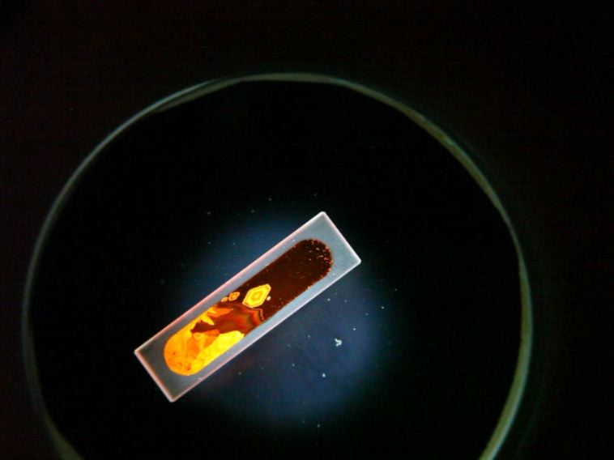
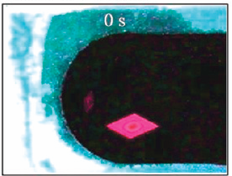
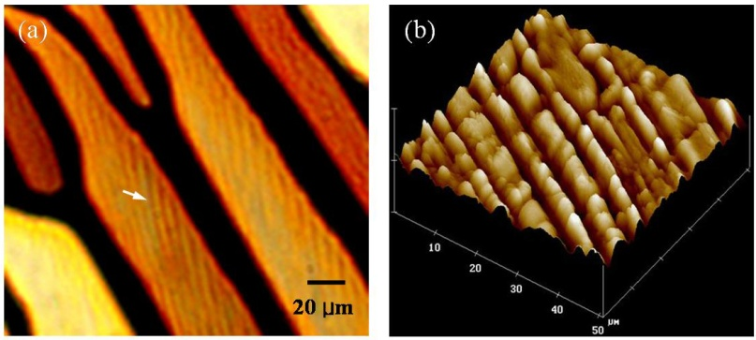

“Photoisomerization Induced Mesophase Transition in Mixtures of Azobenzene and Photocurable Monomers”,
Thein Kyu, Department of Polymer Engineering, University of Akron
As typical for single crystal growths, shallow supercooling generally resulted in nucleation and growth of the stationary rhomboidal single crystal of azobenzene in triacrylate solution. A novel phenomenon of self-propelled crystal motion was discovered at deeper supercooling by simply increasing azobenzene concentration, which has never seen before or known in the field of crystal solidification. The modes of self-motions include swimming, shooting, and sinking. The instability of solvent concentration gradient resulting from solvent rejection from the growth fronts has led to spatial variability of surface tension, known as the Marangoni effect, which is responsible for this novel crystal self-motion. Other notable outcomes include:
Directional motion of the azobenzene single crystals driven by the cis-trans photoisomerization; In collaboration with Professor Dmitry Golovaty, Mathematics Department, University of Akron
Ripple formation in stratified surface of liquid crystalline azobenzene caused by cis-trans photoisomerization; In collaboration with Professor Quan Li, Liquid Crystal Institute, Kent State University
Cascading nucleation events of AC single crystals in diacrylate solutions show different self-motions such as rotation and tumbling with varied single crystal topologies (hexagonal & pyramidal)
hν (blue)
hν (UV)
Fig. 1. Cis-trans isomerization of azobenzene
Fig. 2. (a) Self-propelled motion and (b) directed swimming of azobenzene single crystal upon UV irradiation from left end
Fig. 3. (a) optical micrograph and (b) AFM picture showing stratification due to UV irradiation

