Slide 1
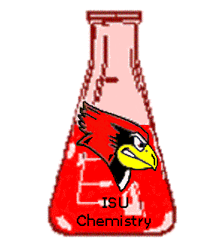
Phosph(in/on)ate Bridged Dimers of Vanadyl Complexes
Craig C. McLauchlan, Illinois State University
ACS-PRF 46064 B3
Layered vanadium phosphates (VOPO₄’s) are used industrially as solid state catalysts to oxidize hydrocarbons. These catalysts are extended structures that function well, but the catalytic mechanism is not well understood. A molecular catalytic species can be more easily studied through conventional techniques. Our model system is based on the CpPCo⁻ ligand shown. Recently we have been investigating a series of complexes with two CpPCoV=O units bridged by phosphates, phosphinates or phosphonates. In pursuing vanadium coordination chemistry, this project focused on materials and catalysis and another parallel project involves bio-mimetic activity of V complexes. These topics have been chosen with student interests and education in mind in that they each expose students to a variety of synthetic and characterization techniques while pursuing some intriguing chemical problems.

