Slide 1
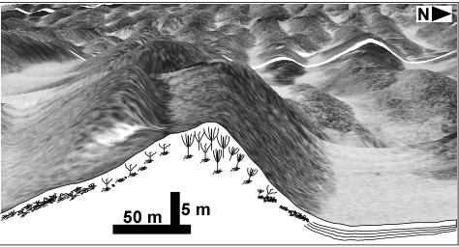
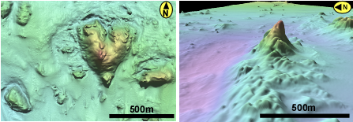
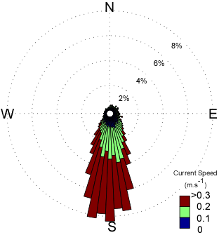
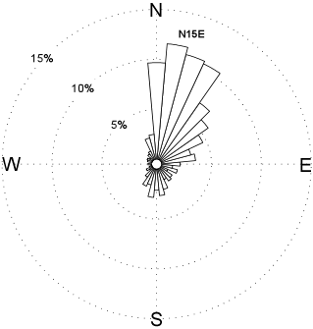
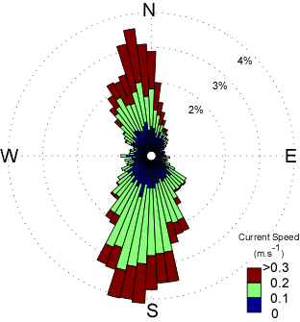
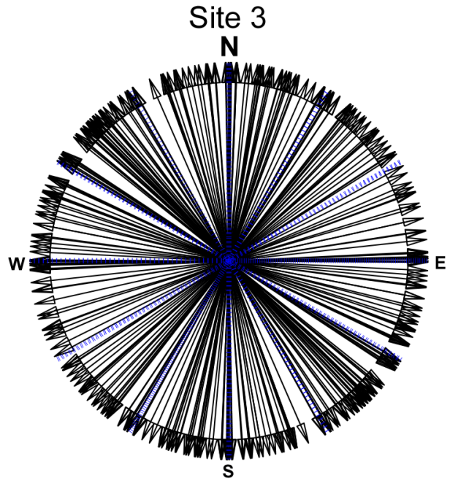
Controls on cold-water coral mound morphology in the Straits of Florida
Gregor Eberli, Thiago B.S. Correa
Miami Terrace site:
Slope sites of Great Bahama Bank:
Regular coral ridge morphology:
Variable coral mound morphology
Unidirectional
current regime:
Spatial orientation of corals:
Bi-directional (tidal)
current regime:
Mound base orientation:
Quantitative analyses reveals positive correlation between dense coral distribution and hydrodynamics
Morphometric analyses shows that variability in mound parameters (e.g. orientation, shape) is correlated with complex hydrodynamics

