Slide 1
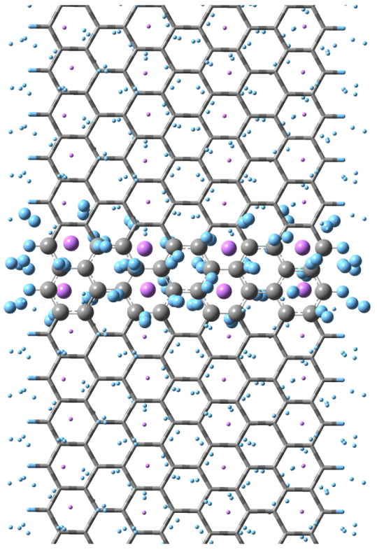
Light Metal Mediated Hydrogen Storage Capacity of Graphene Nanoribbons
Veronica Barone – Department of Physics – Central Michigan University
Using first principles methods, we study light metal absorption on the surface of graphene nanoribbons (GNRs). The recently synthesized GNRs are stripes of graphene with an extremely large length/width ratio. The quantum confinement of electrons along their width gives rise to unique edge effects that dominate their electronic and magnetic behavior. Although their two-dimensional counterpart, graphene, has already been studied in terms of its capacity for absorbing light metals, we show that the symmetry breaking of the two-dimensional lattice (which is a consequence of the finite width of GNRs) affects the absorption energy of alkali and alkaline metals with the potential of producing more efficient anodes for Li-ion batteries as well as hydrogen storage materials.
Gravimetric density
Molecular Formula:
40H₂ + 8Li + 32C + 4H
~15 wt%
DOE target (2015)=9 wt%

