Slide 1
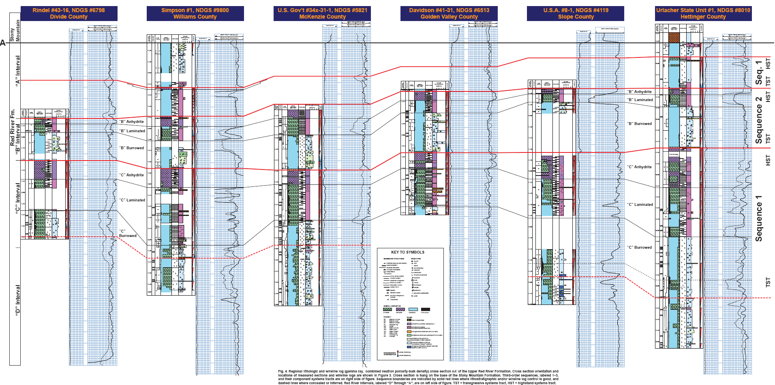
High Resolution Sequence Stratigraphy of Ordovician Red River Formation, Williston Basin, North Dakota
Antun Husinec, Department of Geology, St. Lawrence University, Canton, N.Y.
3
Regional lithologic and wireline log (gamma ray, combined neutron porosity-bulk density) cross section of the Upper Red River Formation, western North Dakota. Cross section is hung on the base of the Stony Mountain Formation. Third-order sequences, labeled 1–3, and their component systems tracts are on right side of figure. Sequence boundaries are indicated by solid red lines where lithostratigraphic and/or wireline log control is good, and dashed lines where concealed or inferred. Red River intervals, labeled “D” through “A”, are on left side of figure. TST = transgressive systems tract, HST = highstand systems tract.

