Slide 1
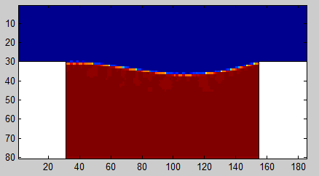
Dynamic Anchoring of Nematic Liquid Crystals by Flowing Oil
R. Pelcovits, Department of Physics, Brown University
G. Crawford, School of Science, Notre Dame University
We are using the unique optical properties of nematic liquid crystals to probe the
“dynamic anchoring” of the surface of a nematic microwell by oil flowing above.
Understanding the interaction between the oil and nematic may provide a novel way
to construct a petroleum field sensor as well as shed light on fundamental liquid
crystal physics. We are carrying out Lattice Boltzmann simulations of “driven cavity flow”,
in this case, oil flowing over a cavity containing liquid crystal.
(a)
(b)
Liquid crystal sensors shown with fluid flow across the open surface at flow rates of (a) 5 mL/min, (b) 10 mL/min.
Lattice Boltzmann
simulation of two-fluid (red
and blue) driven cavity flow

