Slide 1
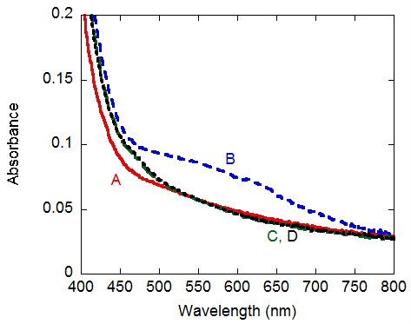
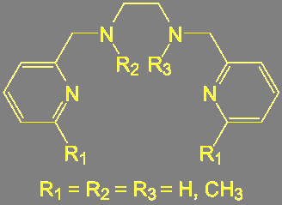
The Synthesis and Hydrocarbon Oxidation Chemistry of Novel Manganese and Iron Complexes
Christian R. Goldsmith, Department of Chemistry and Biochemistry, Auburn University, Auburn, AL 36849
Organohalides are valuable synthons for many industrial processes. Current methods of preparing these compounds suffer from a lack of regioselectivity, leading to large numbers of byproducts. Work in the Goldsmith lab is aimed at developing transition metal catalysts that can install chlorine and bromine atoms onto hydrocarbon molecules more cleanly.
The ligands react with MnCl₂ and FeCl₂ to yield compounds with the general formula [M(L)Cl₂]. These react with oxygen transfer agents to form unstable species (B) with the formula [M(L)(O)Cl₂].
Organic ligands used
These oxidants are capable of chlorinating benzylic and allylic C-H bonds. Two methyl groups are sufficient to block tertiary C-H bonds from the oxidant, rendering the chlorination chemistry regioselective. This also prevents over-oxidation of the substrate. The addition of more methyl groups to the ligand impedes the chlorination at secondary carbons.
A number of methylated derivatives of bis(2-pyridylmethyl)-1,2-ethanediamine (bispicen) were synthesized. These bind to transition metal ions through the four nitrogen atoms. The methyl groups provide a means of limiting substrate accessibility to the reactive portions of coordination complex oxidants

