Slide 1
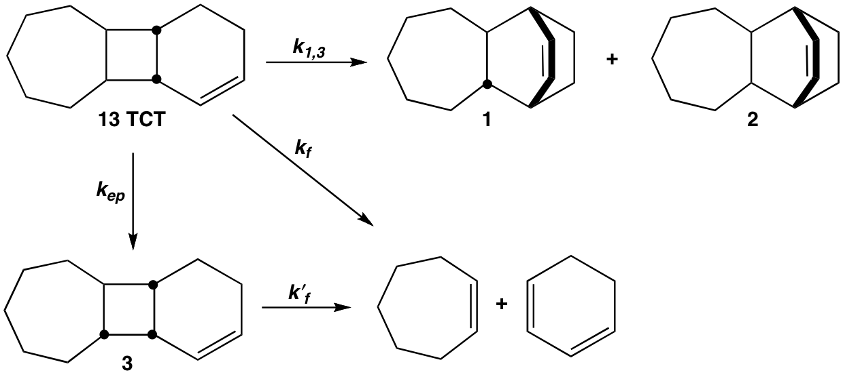
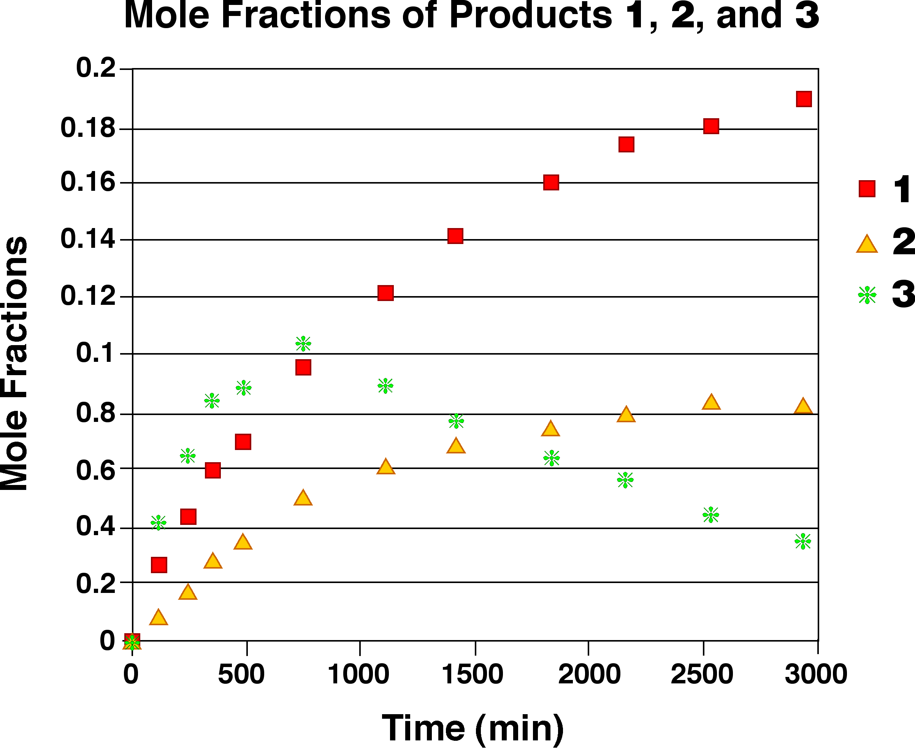
Fundamental Studies on the Nature of Diradical Intermediates in [1,3] Carbon Migrations of Bicyclic and Tricyclic Vinylcyclobutanes
Phyllis A. Leber
Department of Chemistry
Franklin & Marshall College, Lancaster, PA 17604-3003

