Slide 1
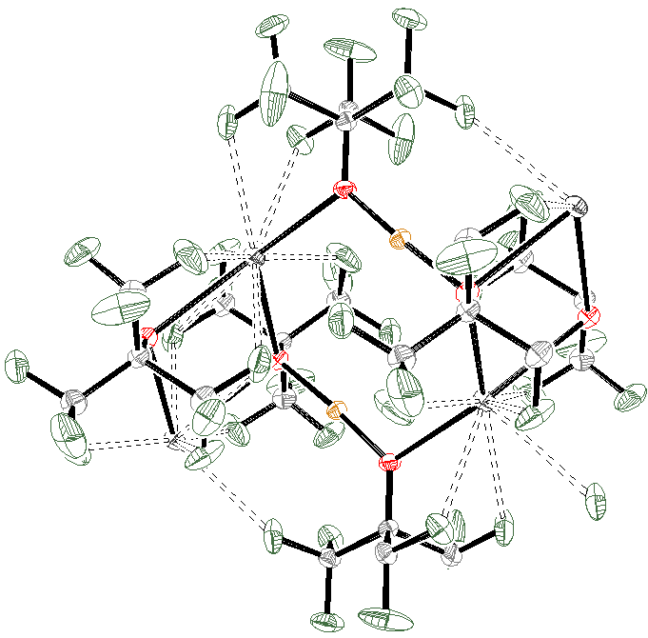
Late Transition Metal Complexes with Fluorinated Alkoxide Ligands for C-H Activation
Linda H. Doerrer, Chemistry Department, Boston University,
590 Commonwealth Avenue, Boston, MA 02215
The Cu(I) fluorinated alkoxides react with O₂ in a manner that depends on concentration as well seem to require K…F interactions to bring multiple Cu centers together.
O2
Cu1
K1
O1
O1
Cu1
K1
O2

