Slide 1
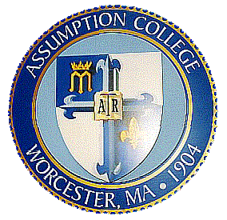
New Synthetic Methodology for Ring Formation
Elizabeth A. Colby Davie
Two projects aimed toward the development of new synthetic methods for ring formation are under investigation. The first project is directed toward using nucleophilic catalysis for the formation cyclobutanones. Several alkenes, reagents, solvents and temperatures have been studied, but the desired reactivity has yet to be observed.
The second project is directed toward the synthesis of the naturally-occurring compound schischkiniin. This polycyclic structure is intriguing due to its symmetry. An oxidative dimerization method for closing the largest ring within the structure has been explored. Additionally, a photochemical reaction to install the four-membered ring has been studied. The synthesis is still underway.
A third project has been inspired from the work on schischkiniin. The synthesis of a related natural product, montamine, using a bidirectional synthetic strategy is under investigation. All three steps of this strategy have been shown to be successful in initial experiments.

