Slide 1
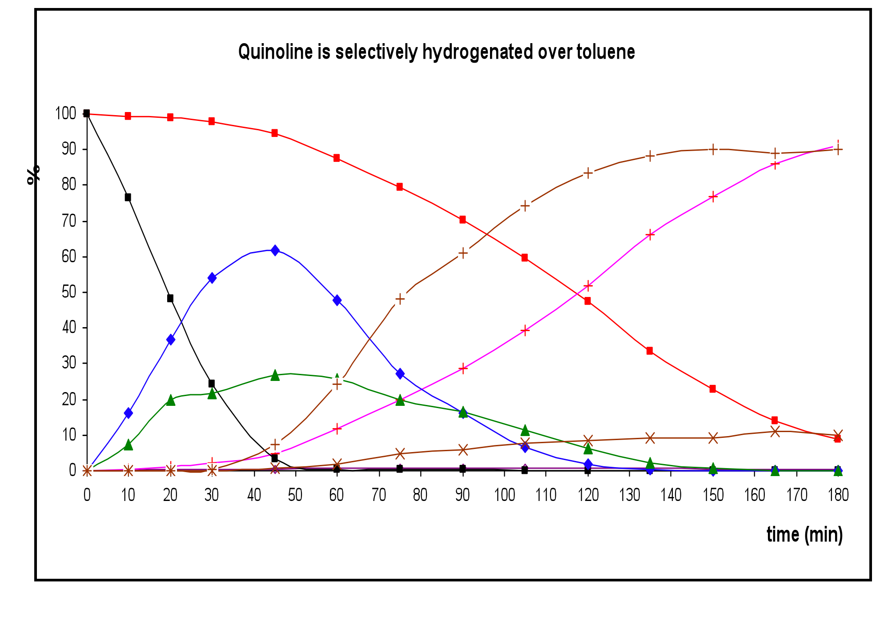
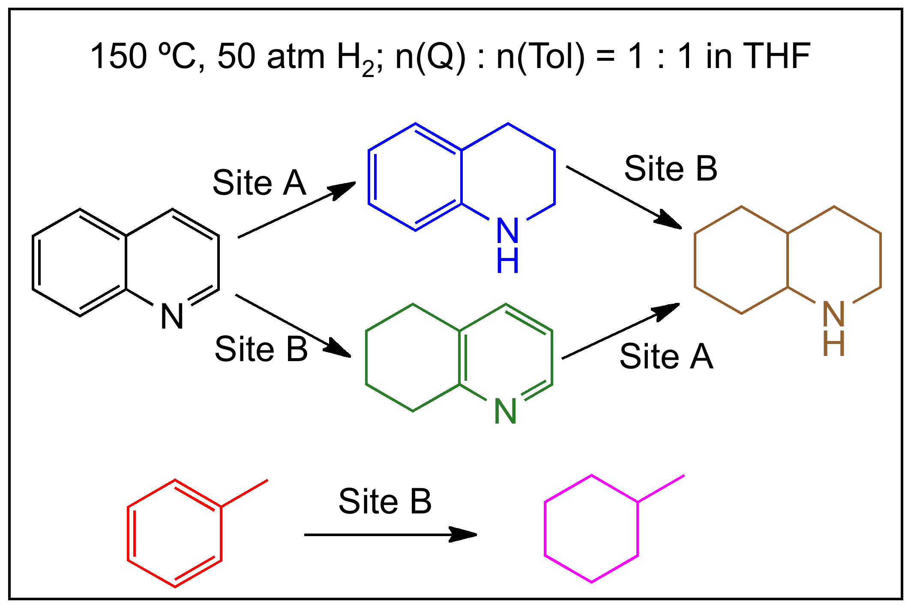
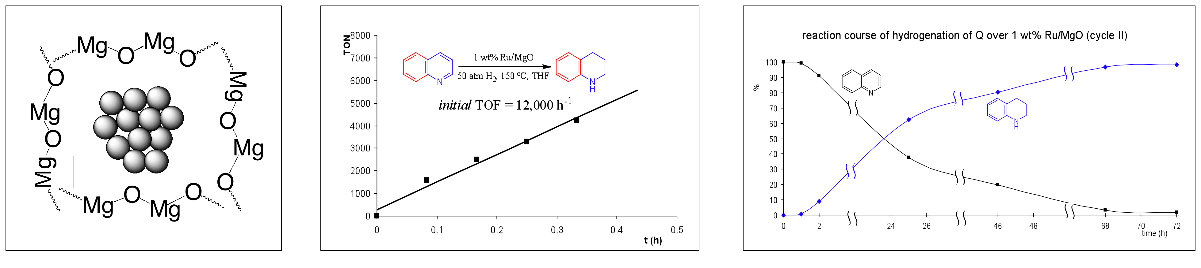

Heterolytic Activation of Hydrogen Promoted by Ruthenium Nanoparticles on Poly(vinylpyridine)
and Hydrogenation of Aromatic Compounds
Roberto A. Sánchez-Delgado, Chemistry Department, Brooklyn College, The City University of New York
1st generation catalyst: Ru nanoparticles on poly(4-vinylpyridine) create two distinct catalytic sites
for the hydrogenation of carbocyclic and N-heterocyclic aromatic rings
2nd generation catalyst: Ru nanoparticles on MgO hydrogenate benzenoid and N-heterocyclic aromatics
with very high activities (TOF up to 12,000 h⁻¹ for quinoline)
and shows no sign of deactivation after reducing 50,000 moles of quinoline per mol of Ru

