Slide 1
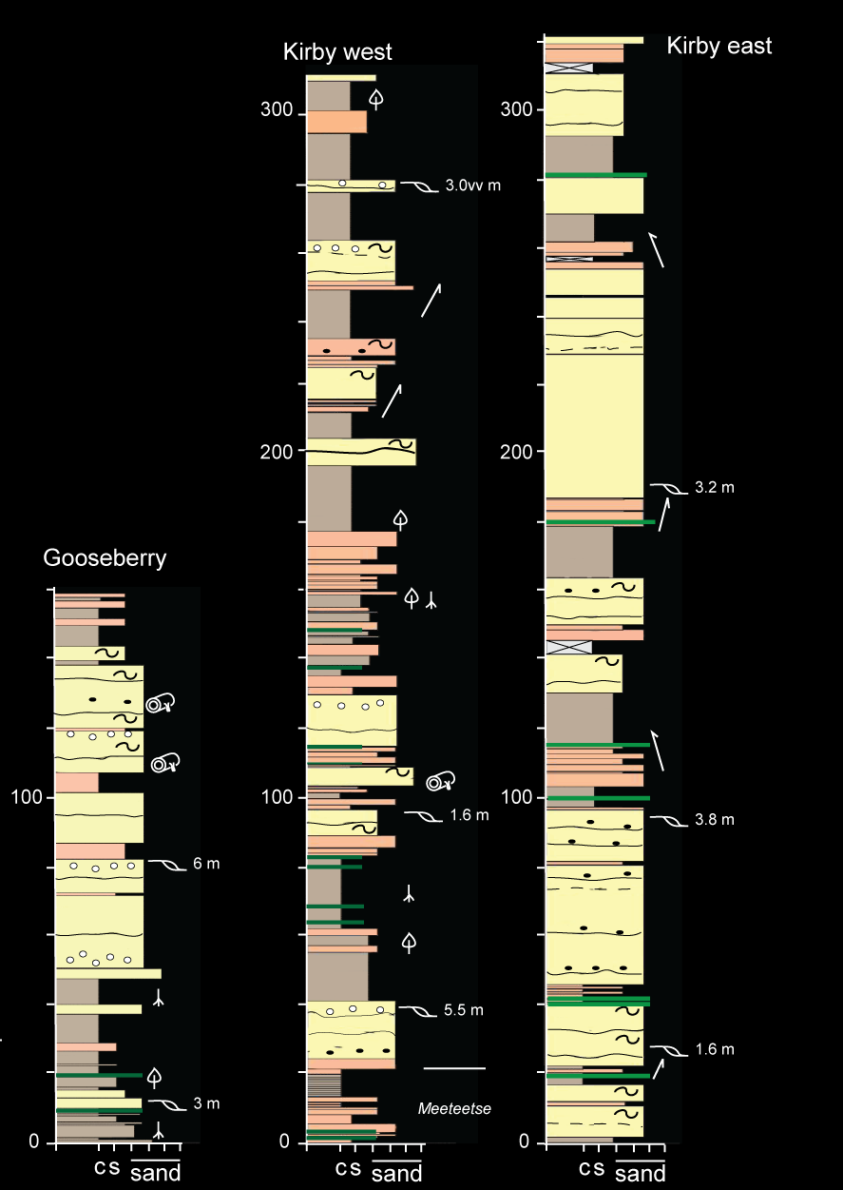
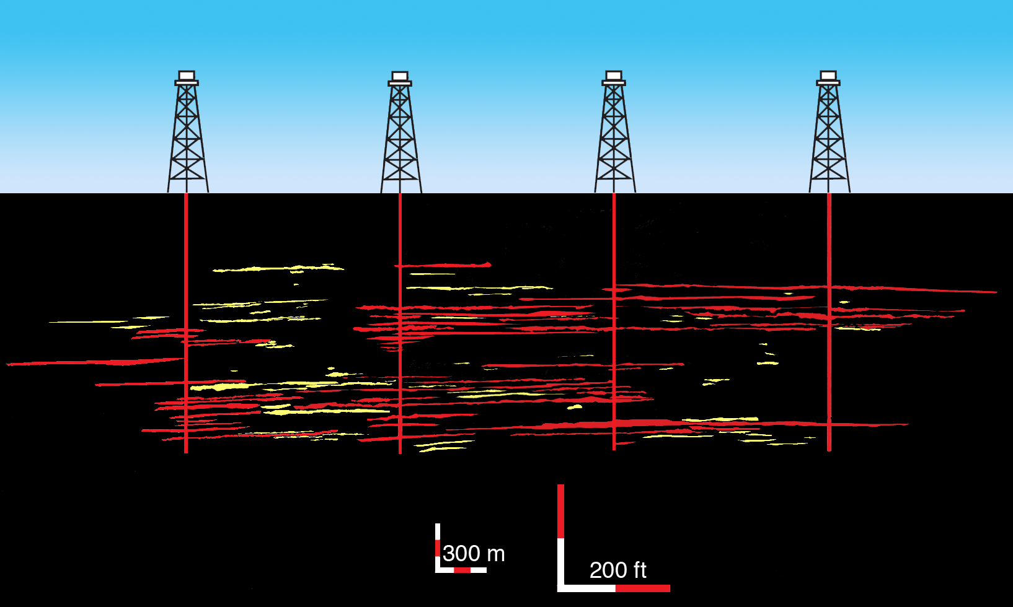
Shapes, Scales and Spacing of Channel-belt Sand Bodies
in Ancient and Experimental Avulsion-dominated Alluvial Basins
Paul L. Heller, Dept of Geology & Geophysics, University of Wyoming, Laramie, WY
Snehalata Huzurbazar, Dept of Statistics, University of Wyoming, Laramie, WY
Chris Paola, Dept of Geology & Geophysics, University of Minnesota, Minneapolis, MN
Channel-belt clusters seen in stratigraphic section (left) and mapped out in cross section (in yellow and red on the right), are common features in alluvial deposits of the Lance and Ferris formations (latest Cretaceous) of Wyoming. These deposits are statistically clustered, as opposed to random or regularly spaced. Comparisons of cluster sizes from across Wyoming suggest that cluster size (width and thickness) is scaled to paleoflow depth of formative rivers. As such, scaling of size, connectivity and drainage (right) can be estimated before developing the reservoir.
Left: measured sections of fluvial deposits in the Lance Formation, Bighorn Basin, Wyoming. Zones of channel-belt clusters are highlighted with red bracket.
Below: Map of channel belt deposits (red and yellow) in cross section through Hanna Basin, Wyoming. Red denotes sand bodies that would be drained by wells at 40 acre spacing. In this example, 82% of all sand reservoirs could be drained by this spacing interval.
BIGHORN BASIN
HANNA BASIN

