Slide 1
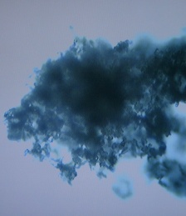
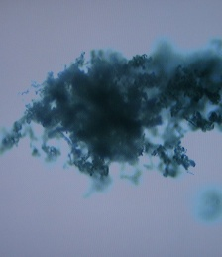
Cellulose Dissolution and Hydrolysis in Acidic Ionic Liquids Ananda Amarasekara Prairie View A&M University, Prairie View, Texas
Dissolution of cellulose
Hydrolysis of cellulose
t = 0 s t = 60 s t = 150 s
Proposed mechanism for the hydrolysis of cellulose to reducing sugars and glucose in the acidic ionic liquid medium
Microscope images of rapid dissolution of cellulose in acidic
Ionic liquid 1, at room temperature and atmospheric pressure

