Slide 1
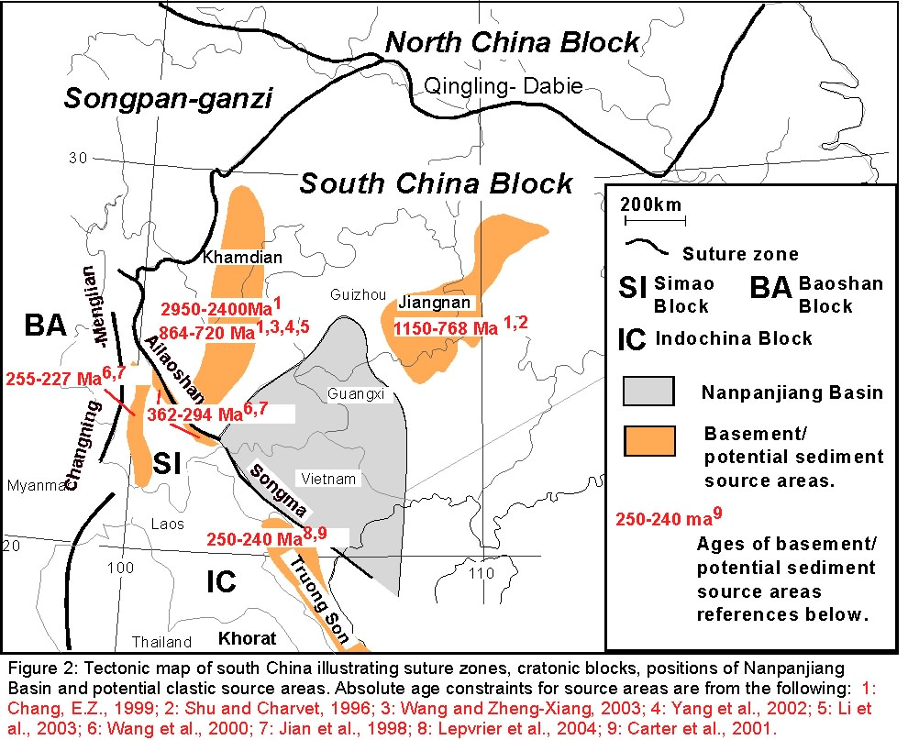
Dan Lehrmann
ACS PRF# 49341-UR8: Patterns of tectonics, provenance, and sediment fill in large complex foreland basins: field, petrographic and detrital zircon analysis of siliciclastic turbidites in the Nanpanjiang basin of south China.

