Slide 1

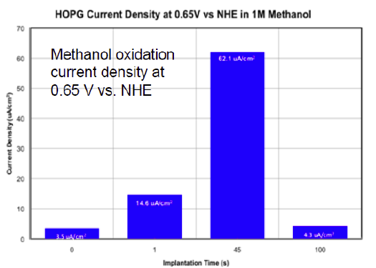
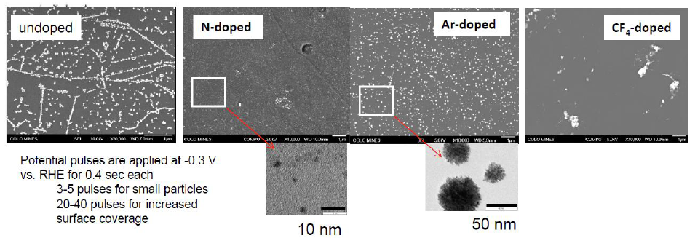
Catalyst Engineering Using Support-Dopant Modification: Towards Intelligent Design of Catalyst Systems
Ryan O’Hayre, Department of Metallurgical and Materials Engineering, Colorado School of Mines
Motivation: Exploit a novel surface-modification technique to enhance the catalytic activity and durability of Pt/C systems relevant to fuel cell applications. Determine the fundamental mechanisms that underpin this effect.
Approach: Our experimental approach uses highly controlled, geometrically simple Pt/graphite test-systems. The fundamental mechanisms and effects of surface dopant modification are explored by comparing the structure, chemistry, and activity of doped versus undoped (control) catalyst systems (fig 1).
Results: Using SEM imaging combined with statistical image analysis methods, we have shown that N-modified graphite surfaces lead to significantly smaller average catalyst particle size and a narrower catalyst size distribution compared to alternative dopants (fig 2). Using electrochemical techniques (IV, CV, EIS), we have shown that 10% surface N-modification appears to lead to optimal catalytic activity (fig 3).
Figure 1. Our experimental approach
Figure 2. 45 sec nitrogen-doping (10% N loading) leads to best catalytic performance.
Figure 3. N-doping provides the best results (small, homogenous catalyst particles)

