Slide 1
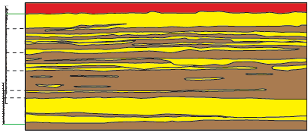
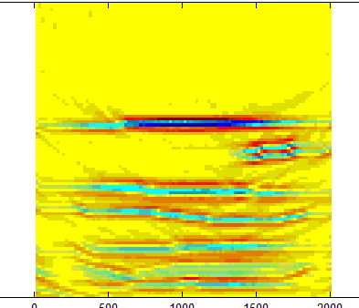
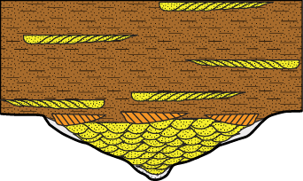
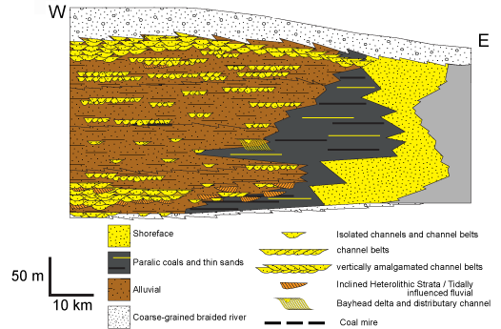
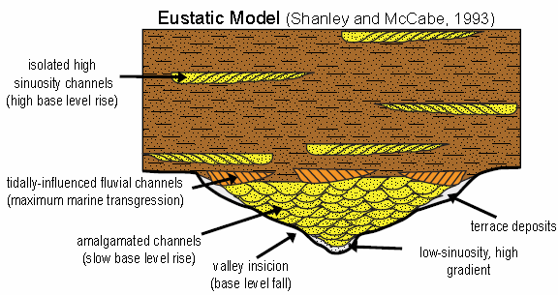
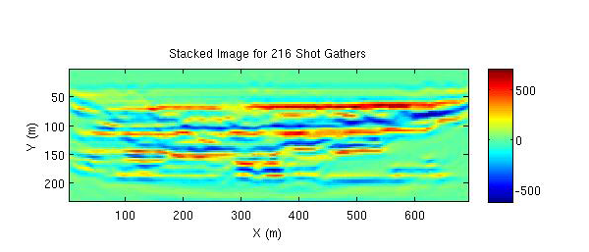
Controls on marginal marine and nonmarine stratigraphic architecture:
New constraints from the Cretaceous Straight Cliffs Formation, Utah
Cari Johnson, University of Utah
Regional correlation of marine to nonmarine facies reveals complex facies and reservoir architecture. Prevailing sequence stratigraphic models do not adequately describe these relationships or the primary controls on the time-space evolution of fluvial systems. Results lead to improved prediction and imaging of subsurface hydrocarbon reservoir analogs.
Outcrop Characterization → Improved Depositional Models → Reservoir Prediction
Reservoir Prediction

