Slide 1
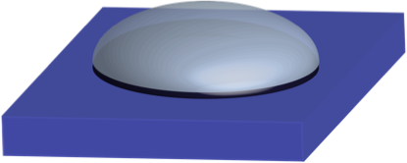
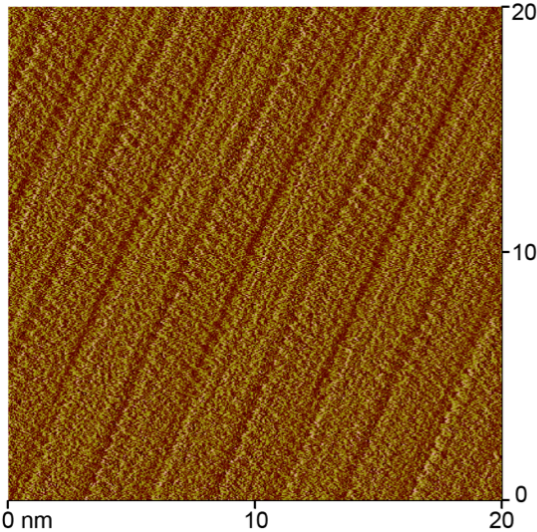
Adsorption of Thiophenes at Liquid/Solid Interfaces
Katherine E. Plass, Department of Chemistry, Franklin & Marshall College
-containing solution
The self-assembly of a series of structurally related alkyl-decorated thiophenes has been examined at the liquid–graphite interface to develop an improved understanding of this process, which can exert the profound influence on interfacial properties. We have focused on the self-assembly behavior of simple thiophene-containing species observed using scanning tunneling microscopy (STM). Comparison between the monolayers of octadecyl thiophene and octadecanoate thiophene suggests that the pattern of the resultant self-assembled monolayer is responsive to small chemical alterations within the alkyl chain. Future work will focus on explaining this behavior using computational modeling and on exploration of the self-assembly of related species.
graphite
monolayer observed
by STM imaging

