Slide 1
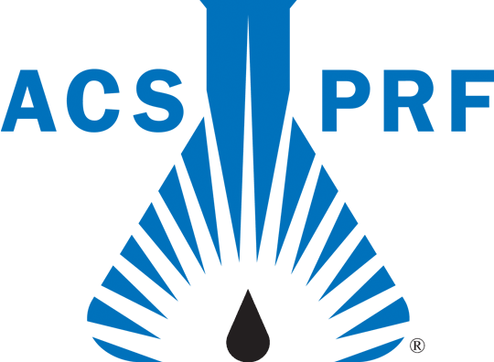
Enantioselective Nucleophilic Catalysis for the Synthesis of β-Lactams and other Nitrogen Containing Heterocycles from Isocyanates
James A. MacKay, Department of Chemistry and Biochemistry, Elizabethtown College, Elizabethtown, PA
A method for the synthesis of β-lactams from isocyanates and alkenes was proposed where the reaction is promoted by nucleophilic catalysis.
Substrates with an electron poor alkene tethered to an isocyanate have been prepared. The desired cyclization using nucleophilic catalysis has not yet been achieved, however, we have demonstrated the key C-N bond formation using stoichiometric alkoxides.
It has been discovered that nucleophiles to catalyze a new variant of the intramolecular Morita-Baylis-Hillman reaction using alkyne acceptors. Several substrates have been prepared and cyclized.

