Slide 1
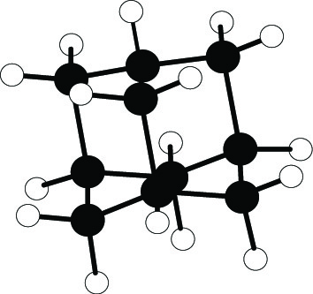
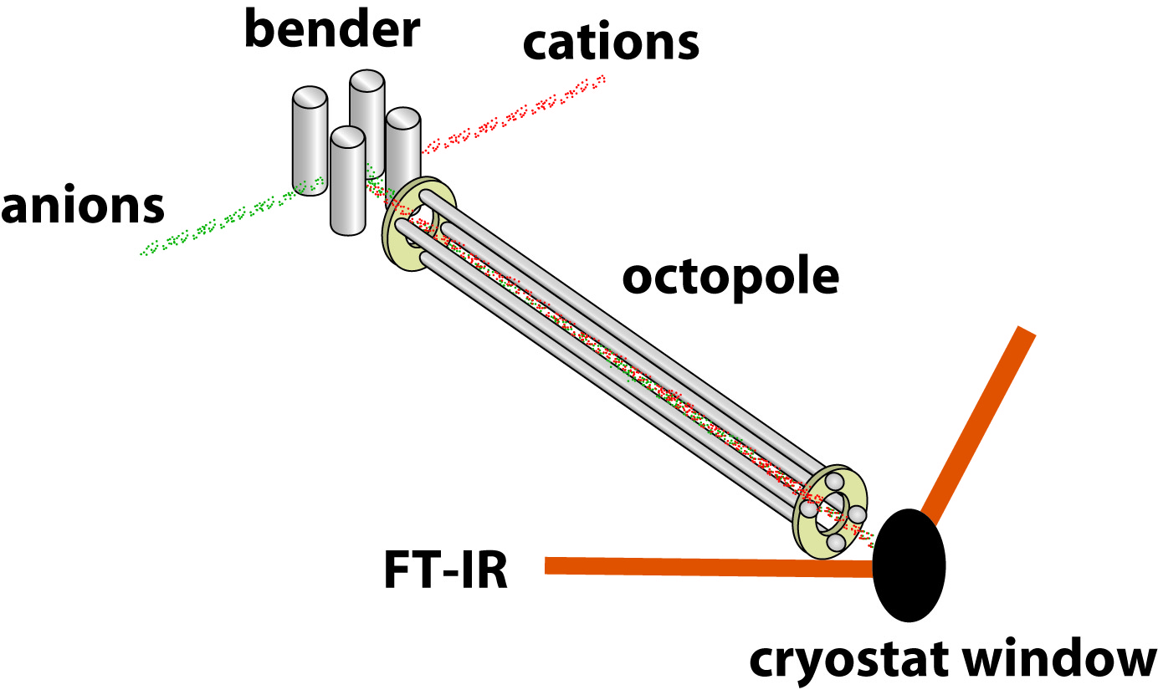
Vibrational and Electronic Spectroscopy of Cationic Diamondoids
Nicolas C. Polfer, Department of Chemistry, University of Florida
Diamondoids are a class of cage-like molecules with sp³ hybridized carbons and terminated by hydrogens.
In this project, diamondoid cations are studied by infrared and ultra-violet absorption spectroscopy.
For this purpose, diamondoid cations are made by electron ionization and are deposited into a cold argon matrix on a cryostat window.
In order to allow neutralization of the matrix, the diamondoid cation beam is complemented by an anion beam (e.g. SF₆⁻).
Adamantane (C₁₀H₁₆) is the smallest member of this family, and has a tetrahedral symmetry.

