Slide 1
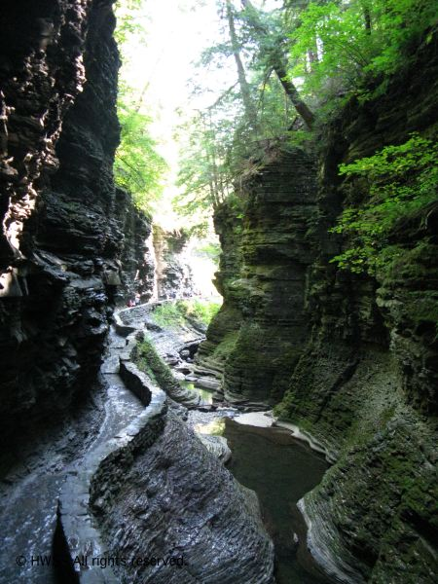
Testing Hypotheses of Black Shale Deposition in the Late Devonian Catskill Basin, Watkins Glen State Park, New York
Nan Crystal Arens
Hobart & William Smith Colleges
δ¹³C_{organic}
Weight % organic-carbon
Several carbon isotope excursions may correlate this section in the Catskill basin of central New York with global sections. Preliminary analysis suggests that intervals of black shale deposition here are not correlative to known events described world wide, suggesting within-basin control of black shale deposition.

