Slide 1
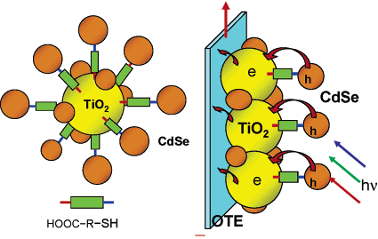
Development and investigation of multijunction hybrids of nanocrystalline TiO₂/quantum dots/conducting polymer nanowires for solar cells applications.
Dr. Justyna Widera, Adelphi University, Department of Chemistry, Garden City, NY 11530
In a dye sensitized solar cell, sunlight is absorbed by an organic dye sensitizer, and the photogenerated charge transports out of the device through a nanostructured percolating titanium dioxide (TiO₂) network. Because organic dyes have a limited spectral absorption range, they are not readily suited to capture all incident solar energy. Inorganic semiconductor quantum dots are an alternative solar cell sensitizer with potential advantages because their spectral light absorption can be controlled by their size and composition.
We proposed to develop a series of devices having spectral absorbance ranges well matched to the incident solar spectrum by using an array of differently-sized quantum dots – thereby providing a pathway to higher efficiencies.
Platinum
Glass
Electrolyte
I
TiO₂/Quantum Dots
I
Notable outcomes from these studies include:
synthesis of CdS nanoparticles with precise diameter control
fabrication of nanocrystal CdS and TiO₂ thin film devices
evidence that under simulated solar illumination the conductance of both CdS and TiO₂ devices increases, consistent with excitation of photogenerated carriers in the semiconductor nanocrystal film network
improvement of TiO₂ structure porosity and brittleness by adding titanium monomers
spectroscopic evidence that direct soaking showed a higher degree of quantum dots uptake comparing to the linker molecule modified TiO₂ matrix
construction and characterization of solar cells from the quantum dot sensitized TiO₂ films
ITO
e⁻
hv
Future studies will focus on charge separation and charge transport measurements of the forward and reverse charge transfer rates from nanocrystal sensitizers to the nanostructured TiO₂ in order to understand the relative merits of nanocrystals versus organic dyes for this device architecture and to better refine the components for better performance

