Slide 1
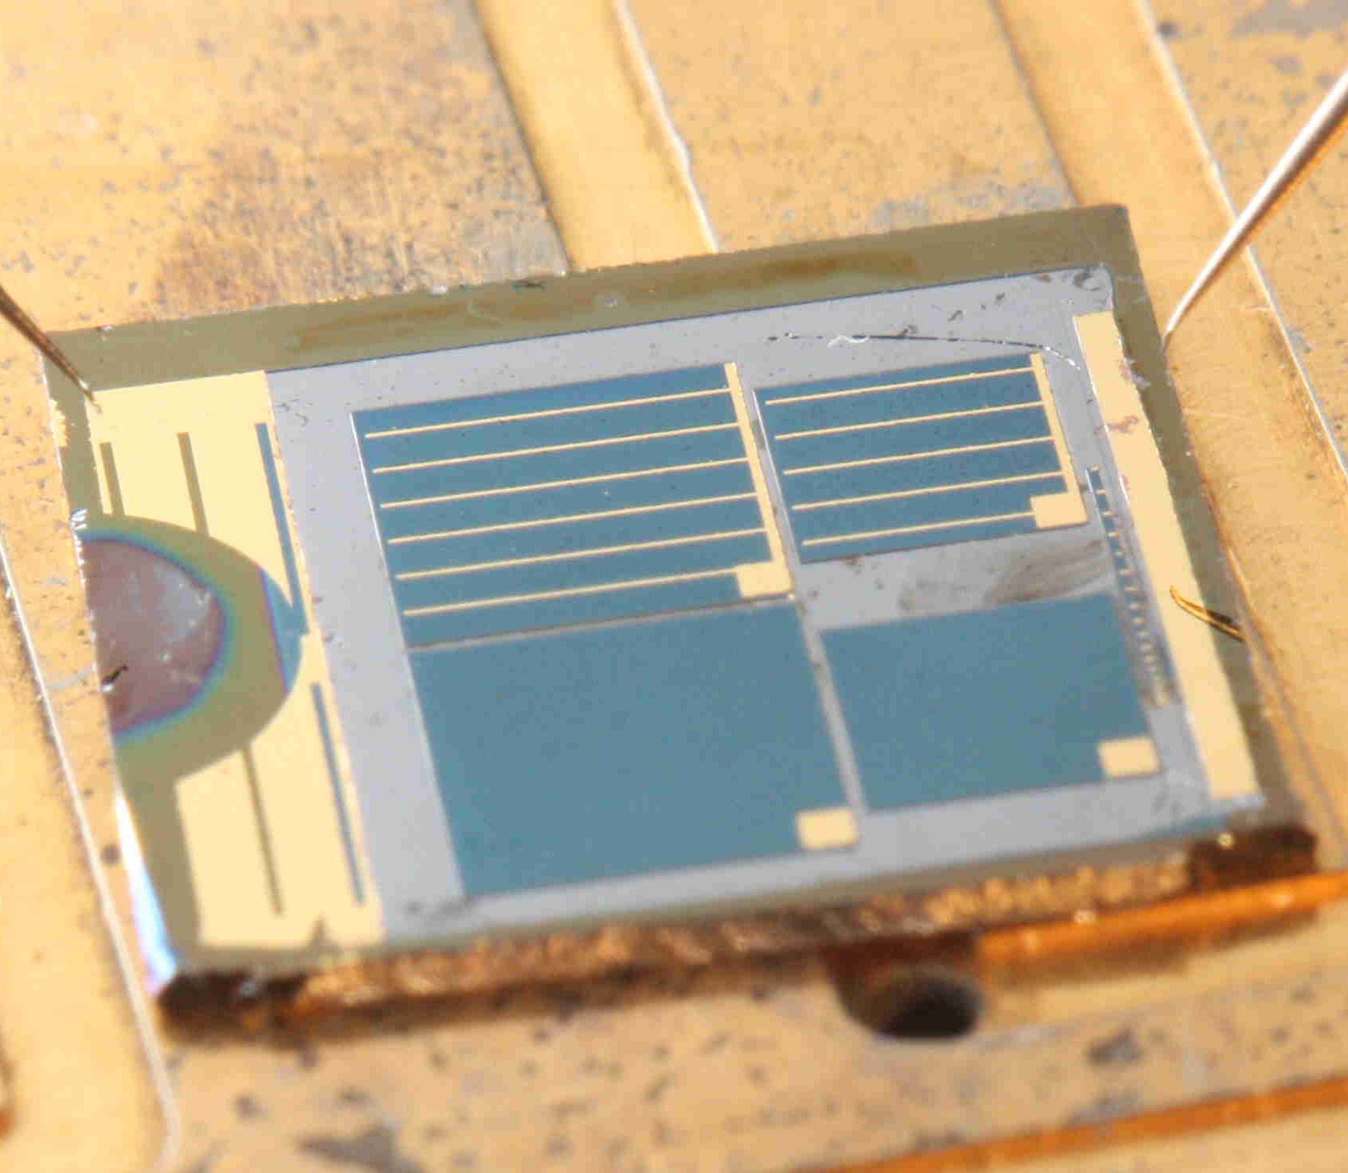
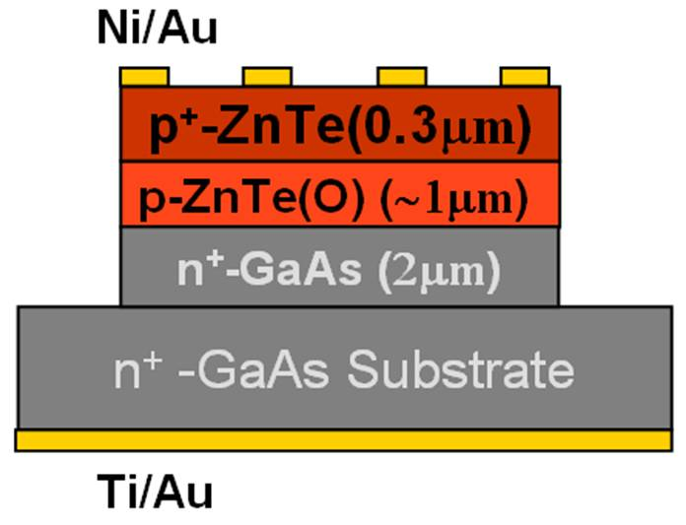
Intermediate-band optoelectronic transitions in ZnTeO for high-efficiency solar energy conversion
ZnTe:O provides intermediate states and bandgap at near optimal energy
Intermediate band behavior observed in ZnTe:O, with long carrier lifetime
Enhanced response observed in ZnTe:O below ZnTe bandedge, higher short circuit current
High efficiency requires better junction
Absorption bands for
Intermediate states
Photo of prototype
ZnTe:O solar cell
ZnTe:O
O-States
ZnTe
Time-resolved PL (W. Metzger at NREL)
long carrier lifetime at O states
Response below bandedge in ZnTe:O solar cell and enhanced short circuit current density in comparison to ZnTe
2μm ZnTe:O on GaAs
AM1.5
J. Phillips, University of Michigan

