Slide 1
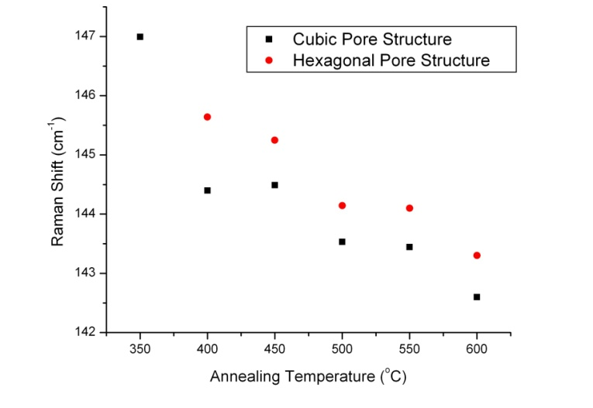
Novel Photonic Structures Using Mesoporous Films
Meso-Silica
3X
Meso-Titania
In both cubic and hexagonal titania mesoporous films, the antase-peak near 150 cm⁻¹ red-shifts with increasing annealing temperature, a result that indicates the effect of crystal size on the vibrational modes.
A photonic crystal (1-D) consisting of six layers (i.e., 3-periods) of silica and titania mesoporous films show a reflectivity of nearly 90% at an angle of incidence of 75 degrees.

