Slide 1
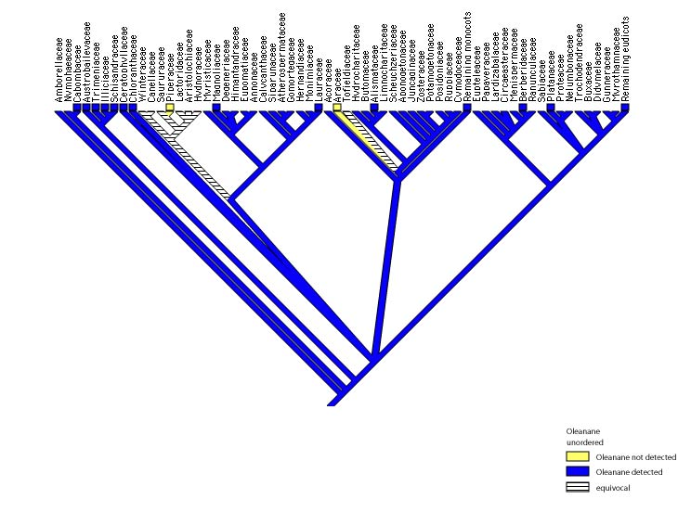
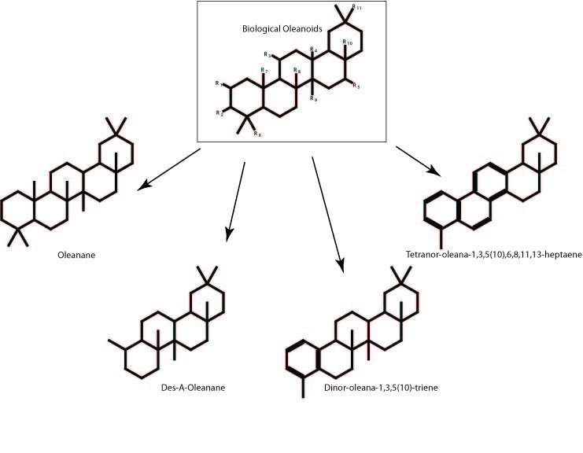
Investigation of Source Material for the Proposed Jurassic – Cretaceous/ Tertiary Angiosperm Biomarker Bicadinane, in Parallel to Known Angiosperm Lineage Biomarker Oleanane
David Winship Taylor, Indiana University Southeast, New Albany IN.
Preliminary analysis of a suite of living flowering plants, that were treated to mimic burial and preservation, are found to have oleanane or des-A-oleanane. Oleanane has previously been reported in the fossil sediment and oil record and thought to be from flowering plants which this supports. Des-A-oleanane has also been reported but living sources were unknown. This is the first evidence of des-A-oleanane from flowering plants.
Our data show that biologically active oleanoids are the procurers to several diagenetic products including oleananes and des-A-oleanane.
Parsimony MacClade reconstruction supports the hypothesis that oleanane is ancestral in angiosperms.

