Slide 1
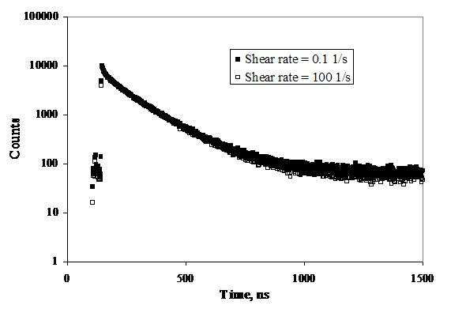
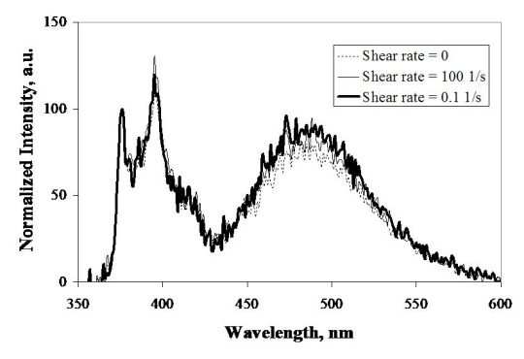
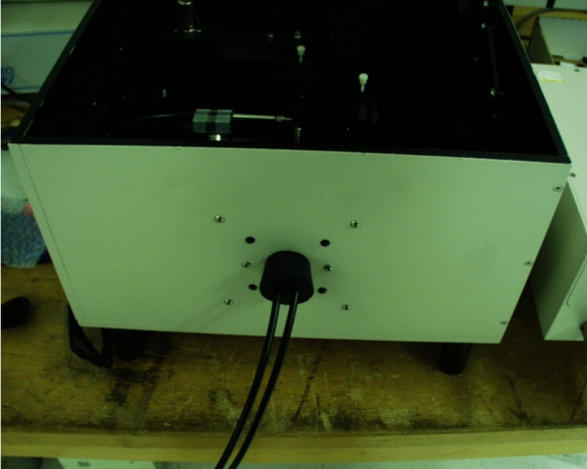
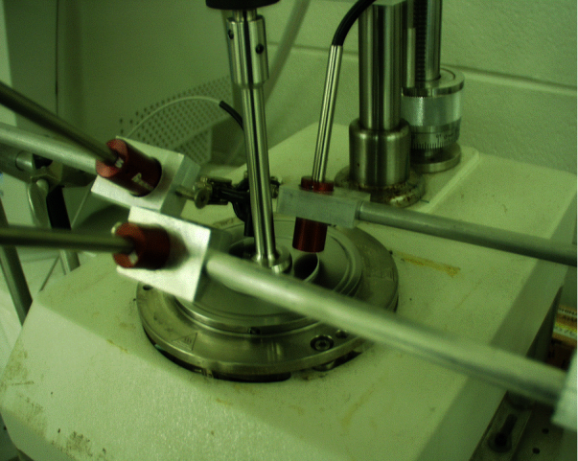
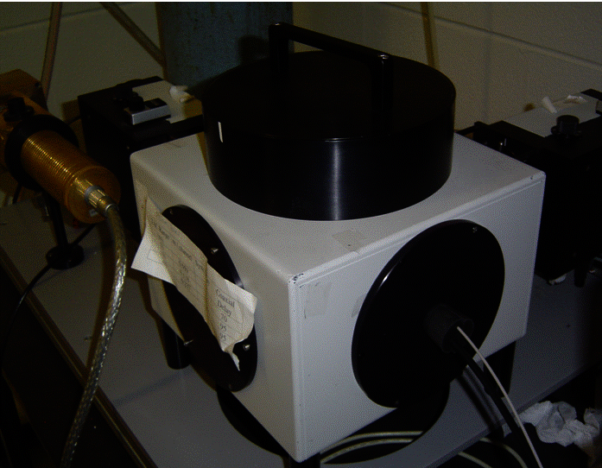
Complete Characterization of Solutions of Associative Thickeners by Using a Combination of Fluorescence and Rheology Experiments
Jean Duhamel, Department of Chemistry, University of Waterloo, Waterloo, ON N2L 3G1, Canada
Steady-state (left) and time-resolved (right) experiments can be conducted simultaneously on pyrene-labeled associative thickeners while the solution is being sheared in the rheometer (center).
Steady-state fluorometer
Time-resolved fluorometer
Py-WSP solution irradiated via the optical fiber
Quartz Plate
Rheometer

