Slide 1

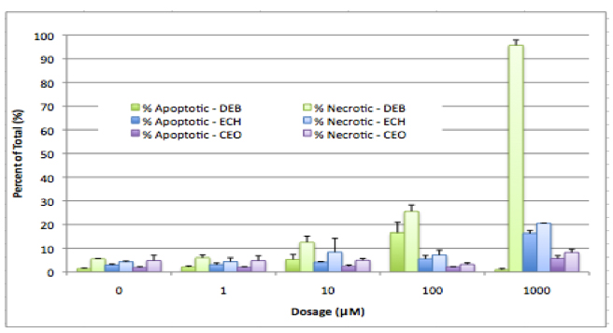


Epihalohydrin Cross-Linking of DNA
Julie T. Millard, Department of Chemistry, Colby College, Waterville, ME 04901
Occupational exposure to bifunctional alkylating agents such as the epihalohydrins can increase cancer risk, an observation attributed to the formation of DNA interstrand cross-links. Our goal is to determine the molecular factors involved in the biochemical activity of the epihalohydrins. This year, we have focused on two different aspects of epihalohydrin reactivity:
  the structure-function relationship of cross-linking and cytotoxicity
  the epichlorohydrin mechanism of cell death
Project 1
Project 2
Correlation between occupational exposure to chloroprene and lung cancer has been reported. The active compound is believed to be (1-chloroethenyl) oxirane (CEO), a bifunctional metabolite structurally similar to ECH.
We are exploring the role of apoptosis (programmed cell death) versus necrosis (direct damage) in the cytotoxicity of ECH and related compounds.
Annexin V-FITC/Propidium Iodide (PI) staining coupled with flow cytometry suggests that apoptotic potential within 6C2 cells follows the order diepoxybutane >> ECH > CEO.
We have synthesized CEO and found evidence for DNA interstrand cross-linking at deoxyguanosine residues within 5’-GC and 5’-GCC sequences.
Our data suggest that CEO is both a better cross-linker and more cytotoxic to 6C2 cells than ECH is.

