Slide 1
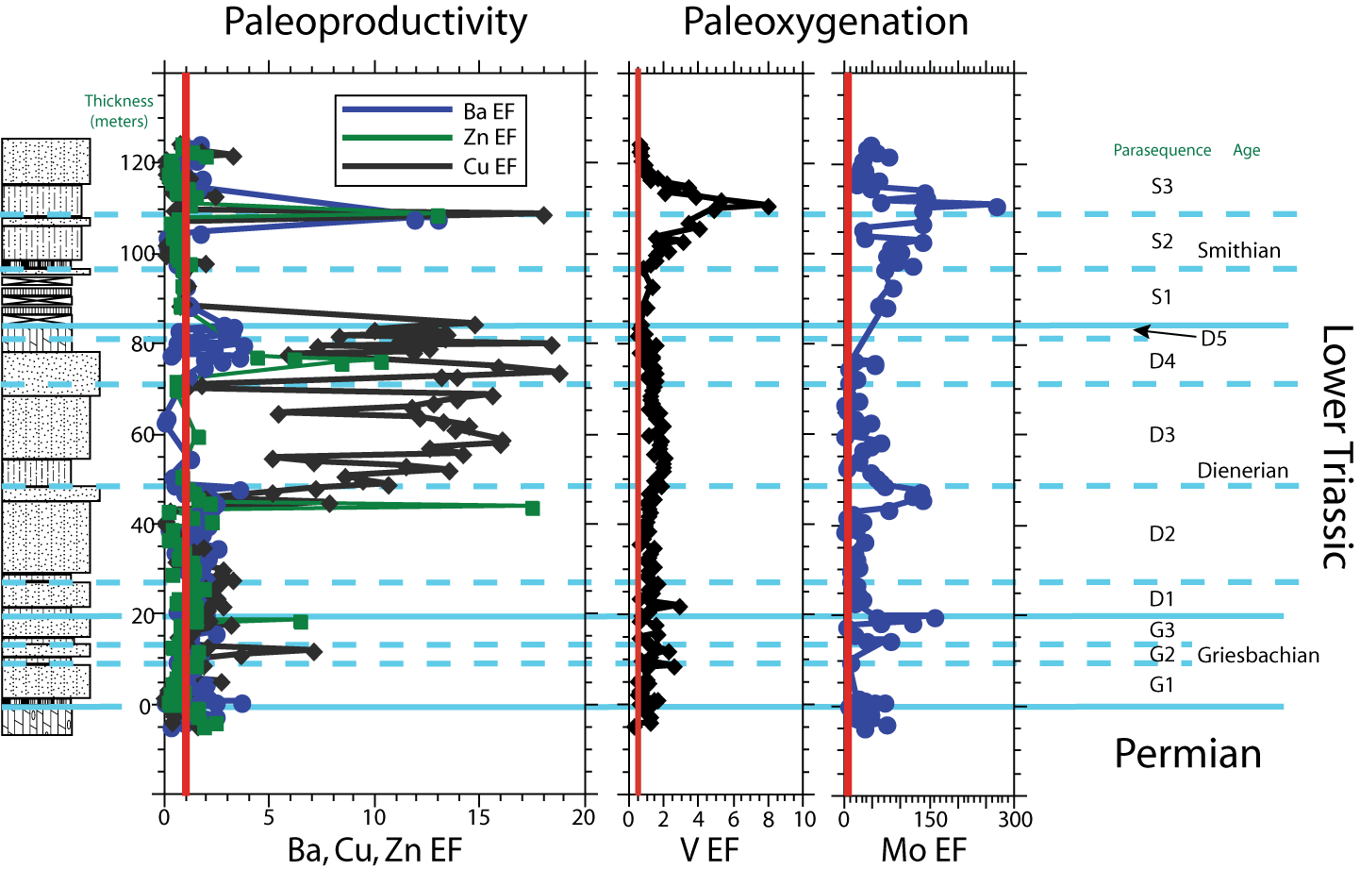
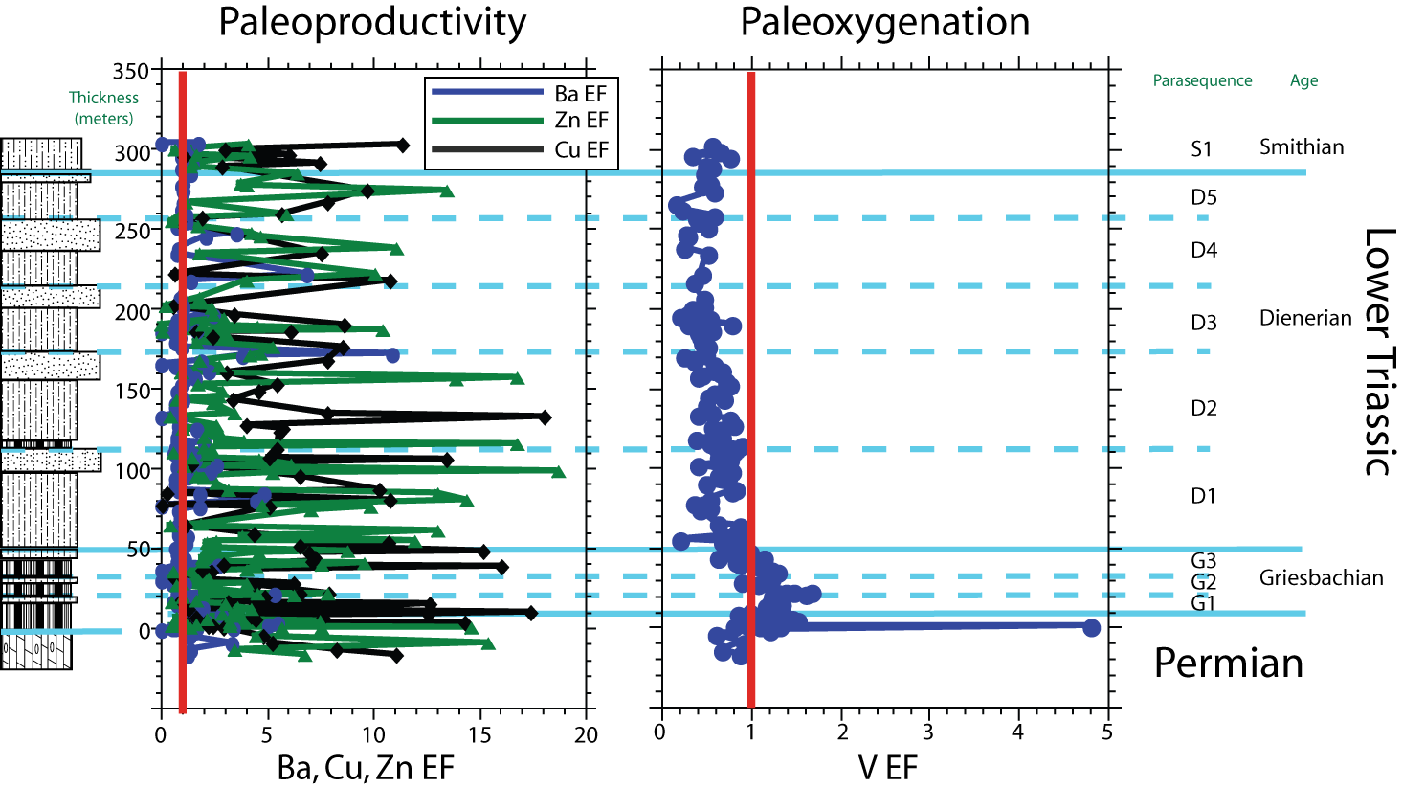
Productivity and Environmental Conditions Following the Permian-Triassic Mass Extinction: Lower Triassic Rocks from the Western Canada Sedimentary Basin
Adam D. Woods Department of Geology, CSU Fullerton, Fullerton, CA 92834-6850
The Cadomin, AB locality of the Western Canada Sedimentary Basin (WCSB) samples lower shoreface depositional environments deposited in the wake of the Permian-Triassic mass extinction (left). Elemental proxies demonstrate temporal variations productivity that correlate to shifts in paleoxygenation across much of the post-extinction interval, and suggest that environmental conditions controlled recovery in this region. Data from the deeper-water basinal facies of the Opal Creek, AB locality (below) differ from the shallower facies sampled at Cadomin, in that they suggest a collapse of paleoproductivity at the Permian-Triassic boundary, which recovered quickly, and remained robust through the remainder of the Early Triassic recovery interval.
Results from Opal Creek (right) also demonstrate that paleoxygenation levels were suboxic to anoxic from the Permian –Triassic boundary through the Griesbachian, and shifted to oxic conditions for the remainder of the Early Triassic. These results may be the result of the more shoreward Cadomin locality being closer to the locus of upwelling, or may be due to local paleobathymetric variations. Continued trace element analysis of samples collected elsewhere in both sub-basins, as well as from the northernmost Liard Basin, should shed light on the reasons for this dichotomy.

