Slide 1
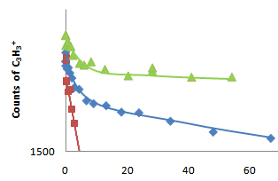
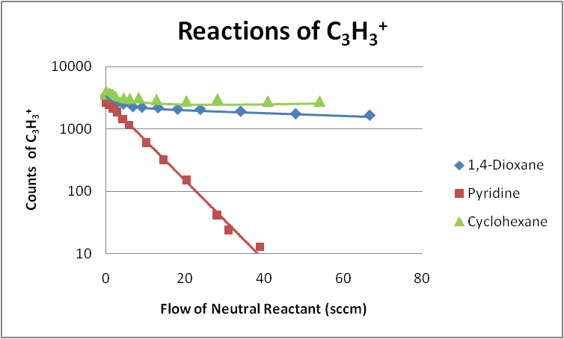
Ion Chemistry of C₃H₃⁺ with Several Cyclic Molecules
Nigel G. Adams, Department of Chemistry, University of Georgia Athens, GA
In this work a series of reactions of C₃H₃⁺with the neutral cyclic molecules shown below is investigated. Both cyclic and acyclic isomers of the C₃H₃⁺ ion were present. By reacting C₃H₃⁺ with benzene, we were able to determine that ~ 30% of the primary ion was the acyclic isomer and the remaining ~70% the cyclic isomer. A Selected Ion Flow Tube was utilized for the measurements to investigate reaction mechanisms.
Hydrocarbon Cyclic Molecules
Oxygen Heterocyclic Molecules
Nitrogen Heterocyclic Molecules
The two distinct isomers of C₃H₃⁺ proved to have different reactivity based on the type of cyclic molecule involved in the reaction. In reactions involving hydrocarbon rings and oxygen containing rings the acyclic isomer reacts at the gas kinetic rate while the rate for the cyclic isomer is typically two orders of magnitude slower. However, both C₃H₃⁺ isomers react at the gas kinetic rate when the neutral is a nitrogen containing cyclic molecule. In many of the reactions association is a very important reaction channel.

