Slide 1
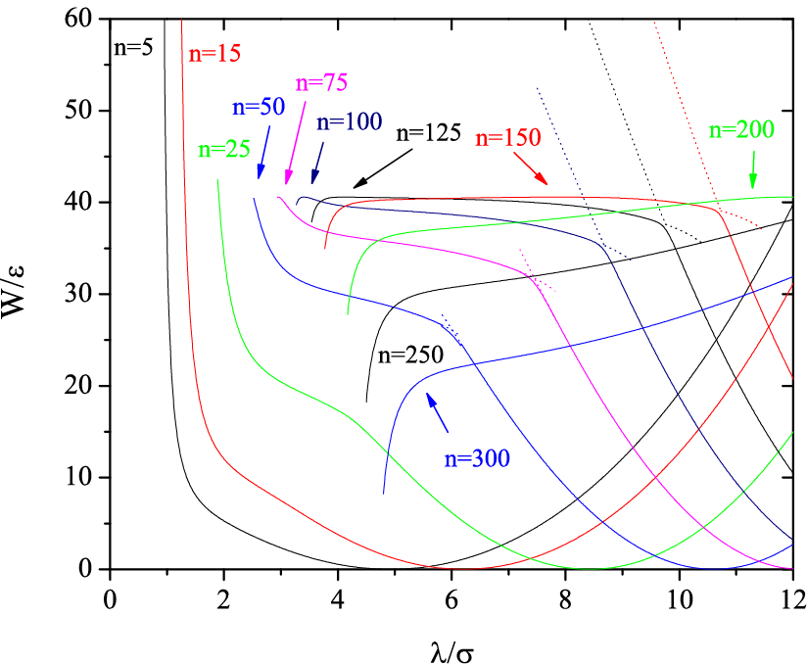
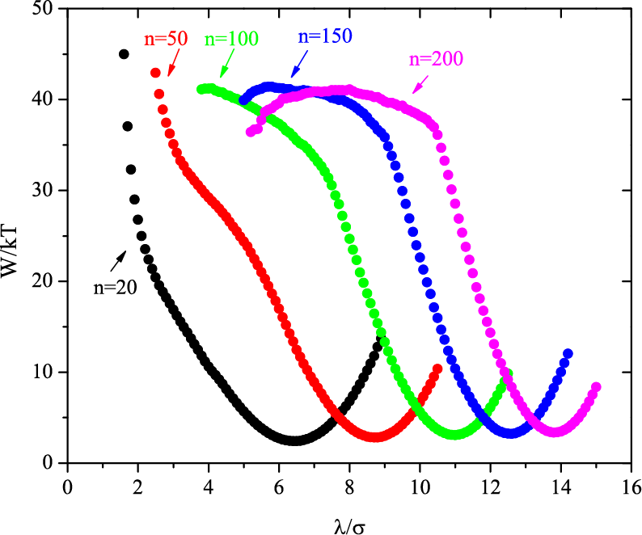
Activated Instability of Homogeneous Nucleation and Growth
David S. Corti, School of Chemical Engineering, Purdue University, West Lafayette , IN 47906
The reversible work, W, of forming a droplet of given n and radius λ within the
supercooled Lennard-Jones (LJ) vapor at kT/ε=0.8 and and ρσ³=0.01 obtained
from constrained density-functional theory (DFT). For n>15, each profile terminates
at a limit of stability. A flat ridge develops, i.e., maxima in W have the same values, for
larger droplet sizes. Hence, homogeneous droplet nucleation is more appropriately
described as an “activated instability”: once the droplets surmount the free energy
barrier the free energy surface serves to channel the embryos towards the stability
limits; the growth phase proceeds via a mechanism appropriate for an unstable fluid.
This is a new and intriguing picture of the molecular mechanism of droplet formation.
ρ*
λ = 2.2σ
The reduced density, ρ*, versus Monte Carlo step after a cavity of radius λ = 2.2σ was placed within a superheated Lennard-Jones liquid. For the given temperature and pressure of the liquid, the cavity at the limit of stability has a radius of 1.8σ. The introduction of a cavity beyond this critical size is found to generate an instability; the density begins to rapidly decrease, indicating that phase separation has begun to occur. These simulations confirm that the limits of stability predicted by the DFT method denote a real transition point between stable and unstable fluctuations within the superheated liquid.
The reversible work, W, of forming a droplet within the supercooled LJ vapor
at kT/ε=0.8 and Pσ³/ɛ=0.01247 obtained from isothermal-isobaric Monte
Carlo simulations. The key features of the DFT predictions, such as the flat ridge
and limits of stability, are verified by the simulation.

