Slide 1
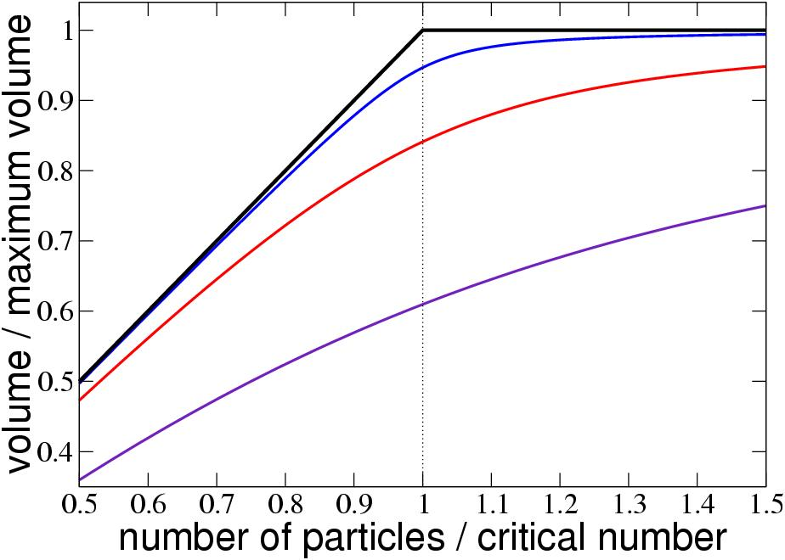
Particle-Encapsulating Vesicles
Haim Diamant, School of Chemistry, Tel Aviv University, Israel
Membrane vesicles (liposomes), encapsulating molecules in solution, are ubiquitous in drug-delivery and cosmetic applications, as well as in key functions of biological cells. Over periods longer than a second these micron-scale capsules are semipermeable – i.e., they exchange water with the surrounding solution while keeping the solute molecules trapped inside. Consequently, their volume and inner pressure both fluctuate. This may lead to unusual, hitherto unrecognized, thermodynamics.
As the number of encapsulated particles is increased, or the outer concentration is decreased, the vesicle swells. A theory developed in this project showed that the swelling toward maximum volume might involve a (continuous) phase transition, as demonstrated by the graphs below. Very recent experiments have indicated, however, that the ability of the membrane to stretch plays a key role. We have been working on extending the theory to include membrane extensibility, aiming at a unified, experimentally supported theory of vesicle swelling toward osmotic lysis.
How does a vesicular capsule swell?
As the number of molecules making the membrane increases (curves from bottom to top), the swelling with the number of encapsulated particles approaches criticality (top black curve).

