Slide 1
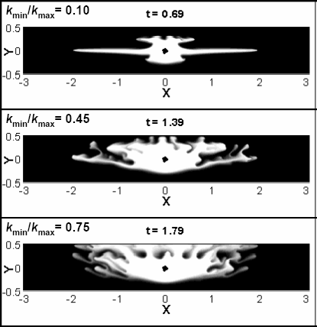
Miscible flooding via horizontal injection wells Eckart Meiburg, Department of Mechanical Engineering, UC Santa Barbara, Santa Barbara, CA 93106
We employ high-resolution simulations in order to analyze the miscible flow fields generated by injection wells with other than vertical orientations. Depending on the ratio of maximum and minimum permeabilities, in both spatial directions, the late-time concentration field resulting from miscible displacements via horizontal injection wells, can be of drastically different shape, indicating vastly different displacement efficiencies. Our results indicate that, under some conditions, horizontal injection wells can yield efficiencies superior to vertical wells.

