Slide 1
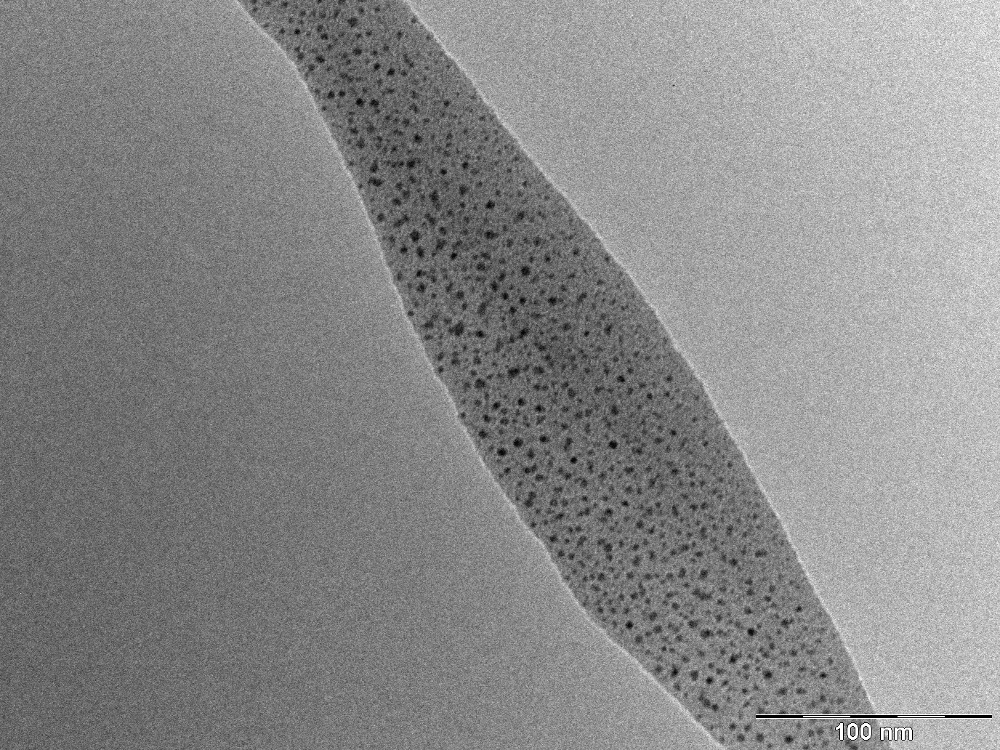
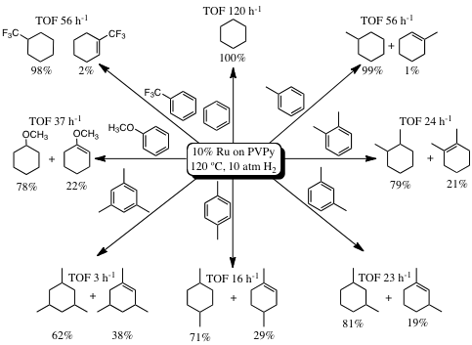
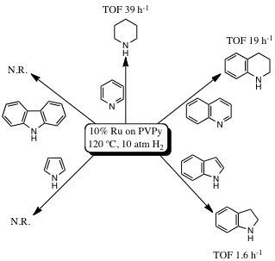
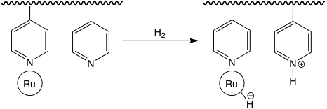
Heterolytic Activation of Hydrogen Promoted by Ruthenium Nanoparticles
on Poly(vinylpyridine) and Hydrogenation of Aromatic Compounds
Roberto A. Sánchez-Delgado, Chemistry Department
Brooklyn College, The City University of New York, Brooklyn, NY 11210
New catalysts composed of Ru nanoparticles on poly(4-vinylpyridine) were synthesized and characterized by use of Transmission Electron Microscopy (TEM).
3.1 nm average size
The new materials efficiently catalyze the hydrogenation of aromatic
and heteroaromatic compounds representative of fuel components
Our next goal is to establish the
importance of heterolytic H2
activation in the catalytic mechanism

