Slide 1
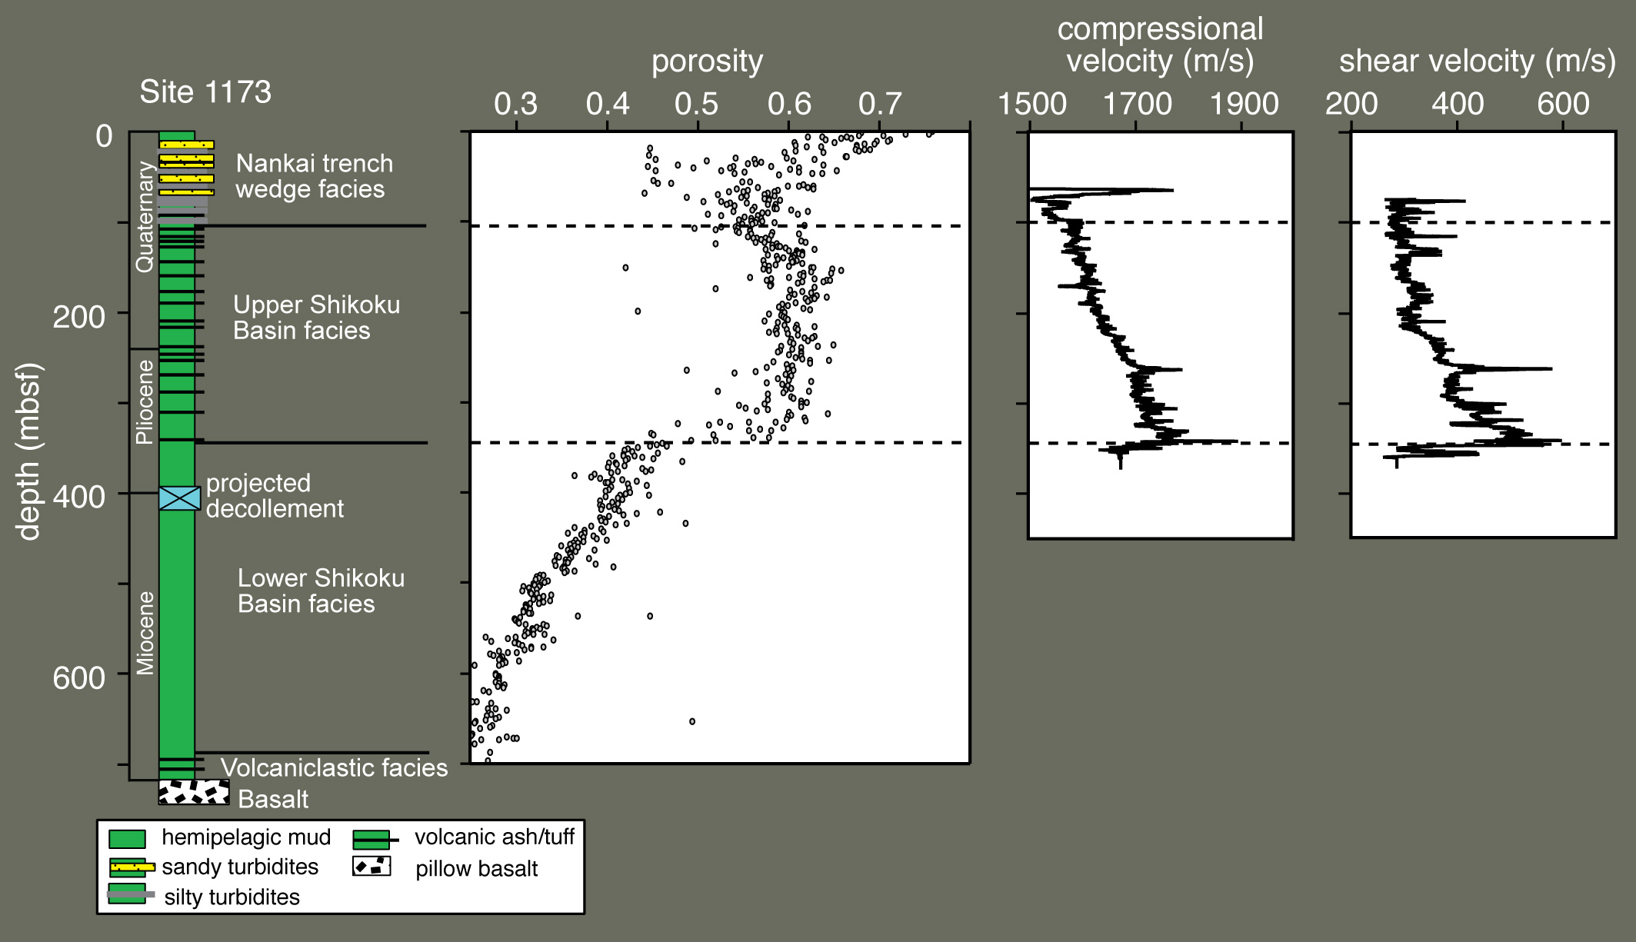
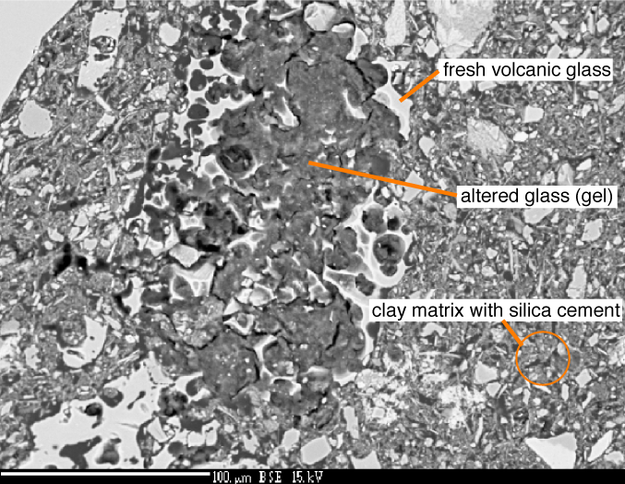
Sediment Stabilization and Anomalous Porosities Resulting from Minor Silica Cementation
Glenn Spinelli, Earth & Environmental Science Department, New Mexico Institute of Mining and Technology, Socorro, NM 87801
In clay-dominated sediment offshore southern Japan, a small amount of material coats clay grains and cements grain contacts which prevents the sediment from compacting. As the sediment is buried, its temperature increases, the cement breaks down, and the sediment compacts dramatically. Understanding the development and break-down of the cement will help with interpretation of the properties and deformation of reservoir seal rocks.
Nature of the cement: Backscattered electron images of the sediment within the cemented section show that volcanic glass shards are being altered to an amorphous gel phase that penetrates the surrounding sediment and may act as the cementing agent.
Effects of cementation: A small amount of cement prevents consolidation of sediment offshore Japan. The cemented section has constant porosity with depth (i.e. it is not compacting); high compressional and shear wave velocities indicate that the cemented sediment is more rigid than the surrounding material. Where the cement fails (~340 meters below sea floor), the porosity and seismic velocities decrease dramatically.

