Slide 1
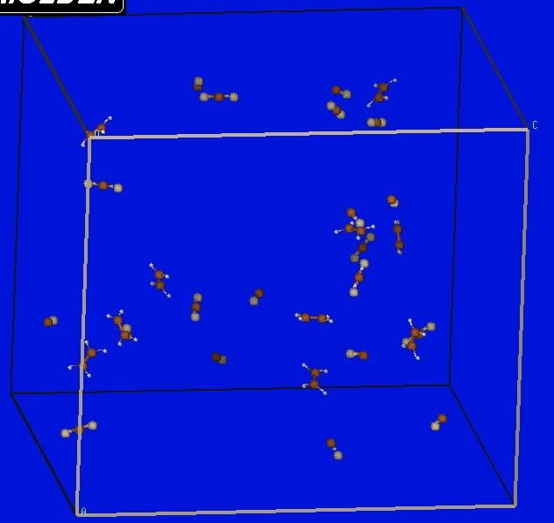
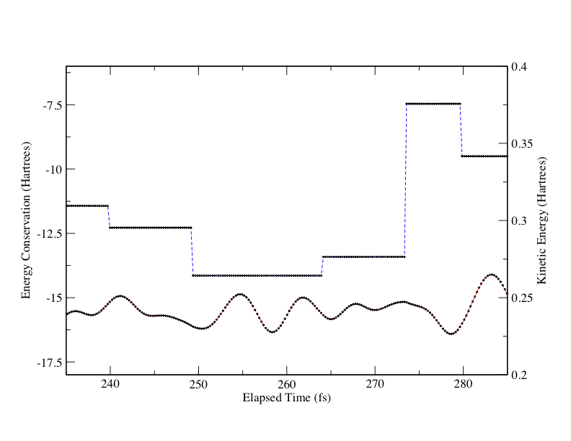
The Development of Accelerated Quantum Molecular Dynamics for Complex Gas-Phase Reactive Systems Michael R. Salazar, Department of Chemistry, Union University, Jackson, TN 38305
A suite of programs called Accelerated Molecular Dynamics with Chemistry (AMolDC) has been written, tested, and employed in order to perform time-dependent, multilevel QM/MM simulations.
110 Atom simulation using MP2/McLean and Chandler, SVWN/6-31G, and RHF/STO-3G levels of theory
Radically discontinuous total potential producing continuous kinetic energy and canonical (NVT) simulations

