Slide 1
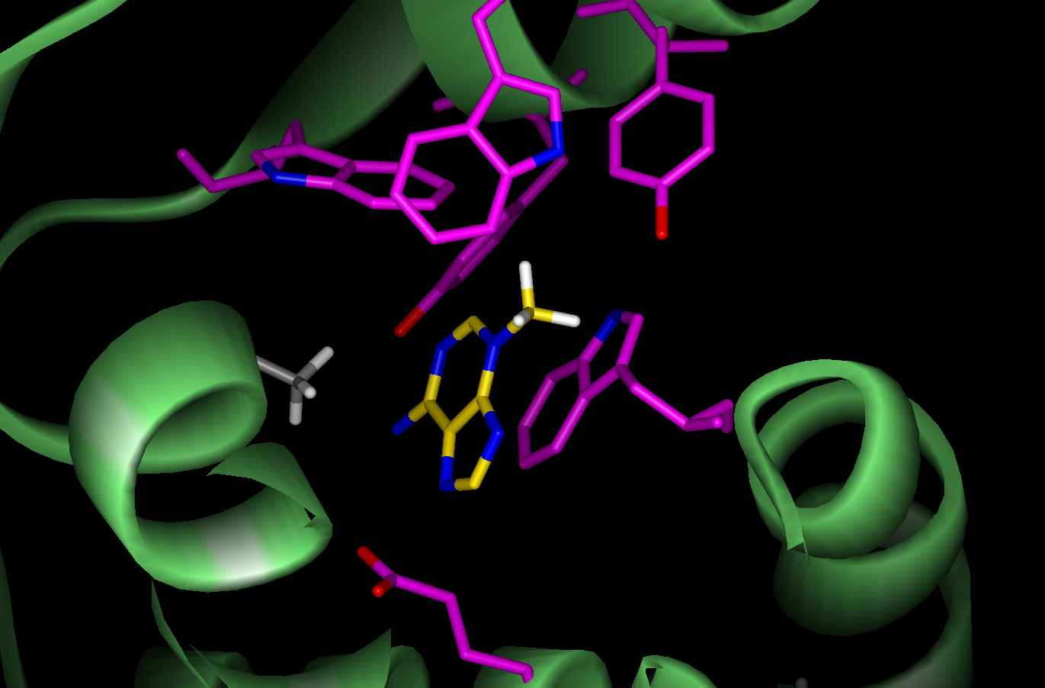
The ACS Division of Biological Chemistry sponsored three symposia at the 236th national meeting in Philadelphia that revolved around a theme of understanding and enhancing the scope of enzyme catalysts. These sessions, which were part of a larger program consisting of twelve symposia and poster sessions, were attended by nearly 800 scientists from the US, Europe and Asia, and presented a unique opportunity to disseminate state-of-the-art fundamental research in the area of catalysis and enzyme design. The relevance of enzyme catalysts to petroleum field extends from the potential of these powerful agents to transform basic hydrocarbons into useful products in an efficient, economical and environmentally friendly manner. The three symposia reflected different fundamental approaches to this common purpose.

