Slide 1
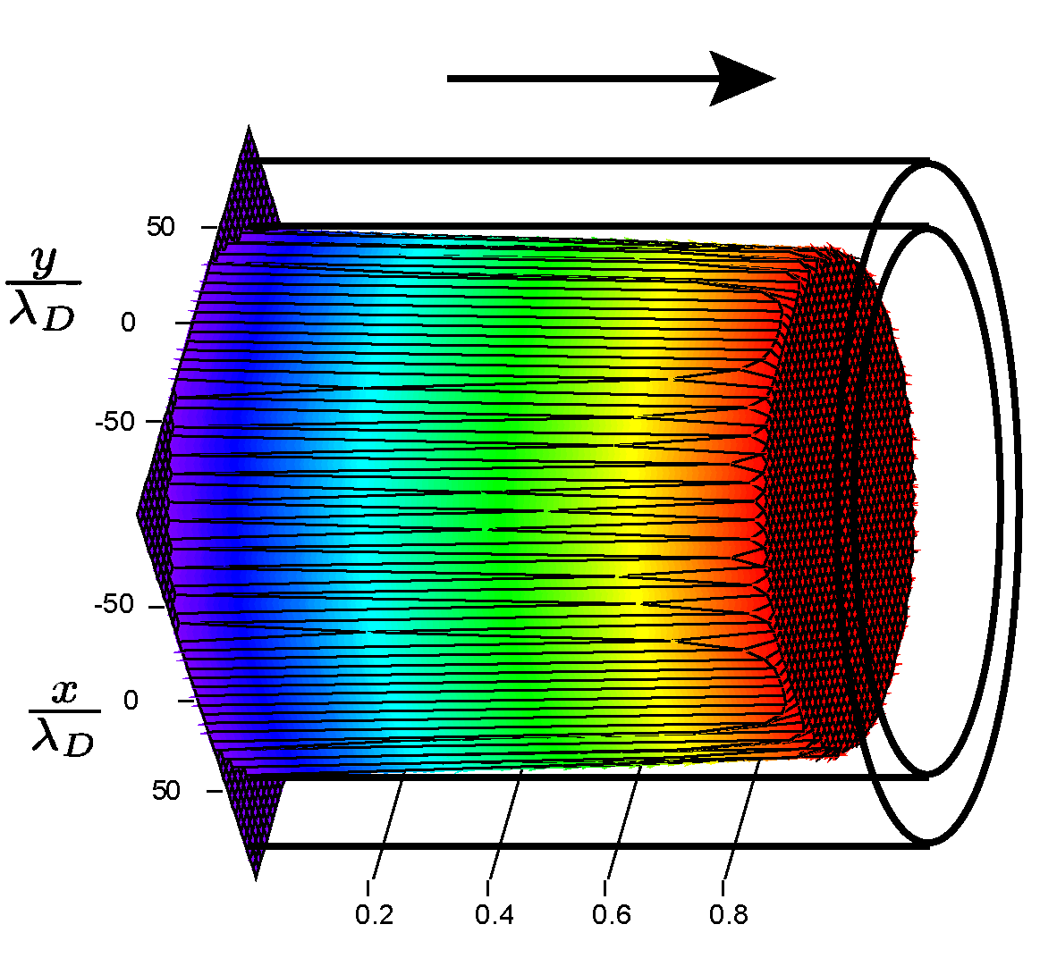
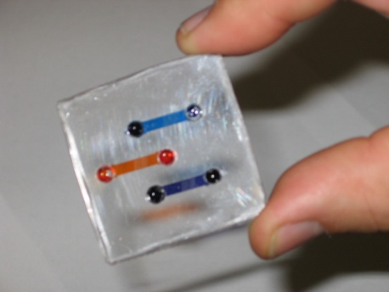
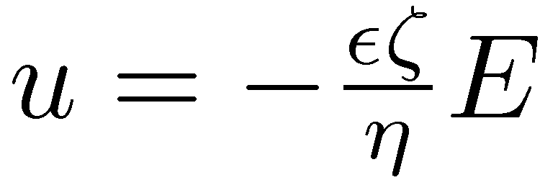
Transient Electrokinetic Phenomena in Hydrophobic Microfluidic Channels
Brian J. Kirby, Cornell University, Ithaca, NY
We often use voltage to actuate flow in microfluidic channels. This flow depends on the ζ-potential, which is related to the chemistry of the fluid-solid interface.
Polymer substrates are becoming more popular in microfluidics, but many polymers are hydrophobic, and water-hydrophobe interfaces are poorly understood.
We have shown that the ζ-potential decays from an initially high magnitude to an equilibrium value in hydrophobic, TOPAS substrates.
The transient decays were also induced by ethanol-water solvent exchanges.
TexPoint fonts used in EMF.
Read the TexPoint manual before you delete this box.: AAAAAA

