Slide 1
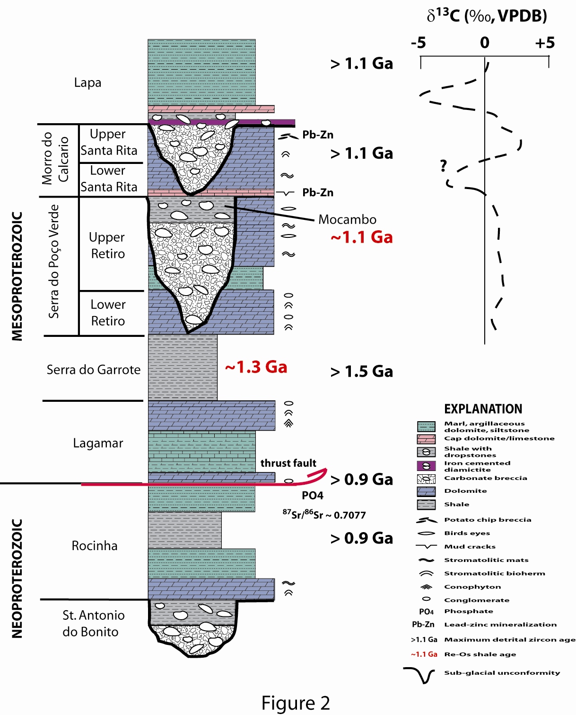
Biomarker Studies of Organic-rich Neoproterozoic Shales from Glaciogenic Successions in Brazil
Alan J. Kaufman, University of Maryland Geology Department
The Upper Vazante Group in Brazil contains two intervals of organic-rich shale with intermittent ice rafted debris, which appear to have accumulated during post-glacial transgression. Total organic carbon contents of the shale horizons range up to 9.8 and 3.5%, respectively. Re-Os ages indicate that these shales were deposited in the late Mesoproterozoic (ca. 1.1 billion years ago). The Upper Vazante Group therefore represents the only radiometrically constrained ice age sediments of the Mesoproterozoic.
Based on an initial data set from a basin-wide distribution of exploratory drill cores we identified a suite of biomarkers and compounds, which included n-alkanes, pristane, phytane, hopanes, and steranes. The ratio of pristane to phytane (0.43-0.66) and the C35 hopane index (4.45-6.74%) indicate reducing conditions at the time of deposition. Additionally, the ratio of steranes to hopanes (0.20-0.23) indicates that although eukaryotes were present, bacteria dominated the microbial community. The biomarker analysis of the Morro do Calcário shale as well as the Lapa and other shale units from the Upper Vazante Group provide insights into the paleontological and environmental conditions present during a previously unrecognized Mesoproterozoic ice age.
C₂₈
Sterane
Distributions
C₂₇
C₂₉
Notes:
-So based on the resuls I was able to make some preliminary interpretations about the depositional environment and biologic source of the biomarkers.
-The presence of steranes in all of my samples suggests eukaryotes contributed to the biologic community. This also implies the presence of oxygen because sterol synthesis requires oxygen.
-This terenary diagram plots the relative abundance of the C27-C29 steranes is highly specific for correlation. The grouping of the samples suggests a similar source for the biomarkers.
-This point is also reflected in the C3122R/C30 hopane. The values are near 0.25 or greater for all but one of the samples indicating a marine depositional setting.
-The low pr/ph ratio may indicate suboxic conditions however this parameter can be affected by thermal maturity. That being said none of the ratios are greater than 3 which indicates there is no input from terriginous matter under oxic conditions.
-The C35 hopane index is around 5% for most of the samples in which the C35 homohopanes were detected. This suggests reducing conditions
-Also, the C29/C30 hopane ratio suggests that some of the samples, the ones with a ratio greater than 1, have an anoxic carbonate or marl source rock

