Slide 1
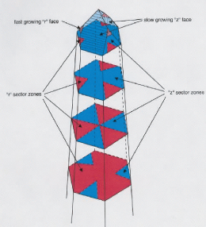
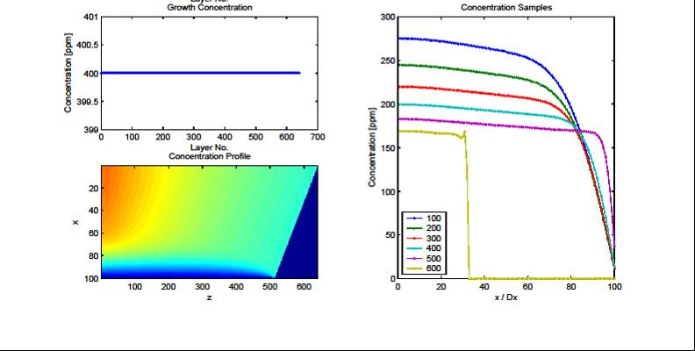
Evolution of Petroleum-Bearing Fluid Systems: Insights from Growth Dynamics of Quartz Crystals
Phillip D. Ihinger, Department of Geology, University of Wisconsin-Eau Claire Eau Claire, WI 54701
Quartz-filled hydrothermal veins are the fossilized remnants of fluid-filled fractures that facilitate the majority of material and heat transfer within the Earth’s crust. The behavior of hydrothermal systems governs the mobility of dissolved ore species and organic compounds related to oil and natural gas formation. The timing and evolution of natural hydrothermal channels are poorly known. We have recently shown the potential of micro-FTIR analyses for revealing variable growth evolutions of individual quartz crystals within veins of variable hydrothermal grade and thus for offering insights into the thermal and chemical evolution of natural hydrothermal systems...
New Findings:
Previous Work:
IR analyses reveal 6 sector zones associated with growth on terminal r & z rhombohedral faces of a specimen from Minas Geras, Brazil (Ihinger & Zink, 2000, Nature, 404, p 865- 869).
FTIR analyses document a 2-stage growth evolution for each crystal in the LeChang vug: an inner ‘core’ formed by growth entirely on rhombohedral faces, and an outer rind of even thickness formed by addition of material onto each of the six prism faces.
Stage 1
Stage 2
Wafers cut perpendicular to the c-axis of each of four crystals sampled from the vug all reveal a 2-stage growth evolution.
Multiple crystals were sampled from a single hydrothermal vug from LeChang, China.
FTIR analyses distinguish growth on m-faces from growth on r- & z-faces. Boundaries between sector zones align with observed optical features.
Finite element modeling can simulate the natural process and successfully reproduce diffusion profiles observed in natural samples.

