Slide 1
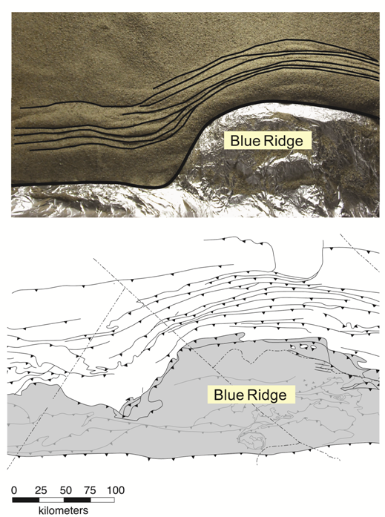
Kinematic Scenario for the Tennessee Salient, S Appalachians
James Hnat and Ben van der Pluijm, University of Michigan
Paleomagnetic directions from remagnetized limestones and redbeds show no correlation with orogenic strike.
Calcite twinning records arcuate pattern that is the same in both the thrust-belt and the foreland.
Patterns reflect (Blue Ridge) indenter scenario that can be duplicated in simple sandbox experiment (lower right).
In contrast to the Pennsylvania salient, curvature in the Tennessee salient is a primary feature.

