Slide 1
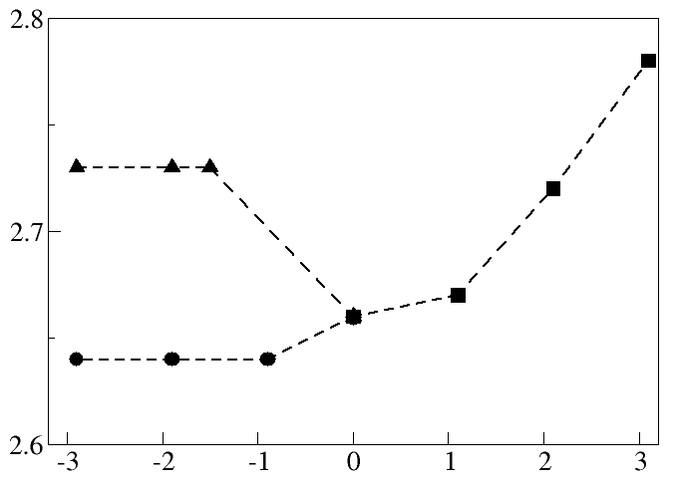
Strain Engineering of Organic Semiconducting Molecules: A First Principles Study
Feng Liu, Materials Science & Engineering, University of Utah
The mechanical manipulation of planar polyfluorenes is taken as a model system for strain engineering molecular optoelectonic properties. Two degenerate structures formed by uniaxial compression which shift vertical transition energies in opposite directions. Mechanical control of optical properties is not just dependent on changes in the absolute molecular length and bonds, but also on morphology.
Transition Energy [eV]
% Strain
Specific adsorption on a silicon substrate is a potential route for practically inducing uniaxial strain. Polyfluorenes can be adsorbed intact along silicon dimer rows, and both tensile stretching and compression can be induced depending on molecular alignment with the substrate. In the adsorption configuration, strain is concentrated in the bonds linking monomer units which can increase conjugation along the backbone and there is charge transfer from the substrate to the molecule. Further studies on the utilization of tethering substituents are of future interest in making the principle of strain engineering practically viable in optoelectronic device applications.

