Slide 1
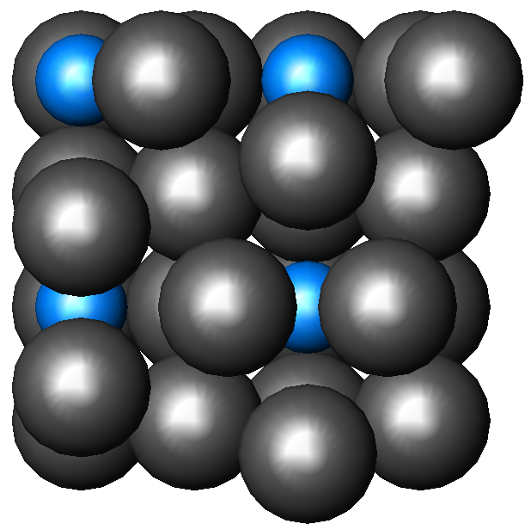
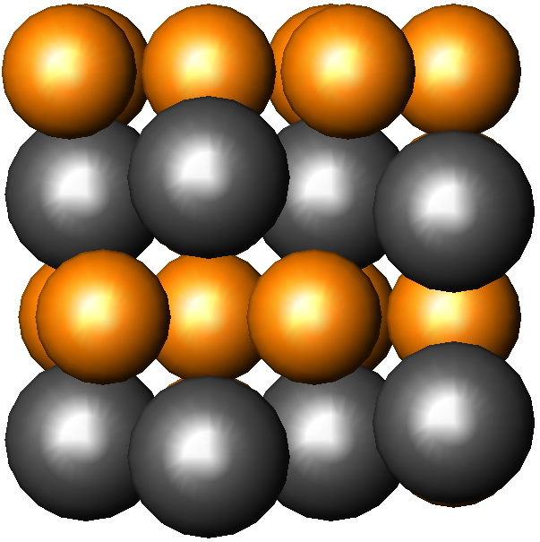
Bonding and Electronic Structure of Reconstructed Surface Alloys
Al/Pd(100) Surface Alloy
Pd/Cu(100) Surface Alloy
In the Al/Pd(100) surface alloy, calculated bond overlap populations indicate that reconstruction into a "clock" configuration strengthens the bonding within the surface plane, as well as bonds between surface Pd and second-layer Pd atoms. In the Pd/Cu(100) surface alloy, the driving force for reconstruction is not apparent because the bonding is more delocalized. We hope to examine the Pd/Cu(100) surface alloy further by comparing the total energies of different reconstructed and unreconstructed structures.

