Slide 1
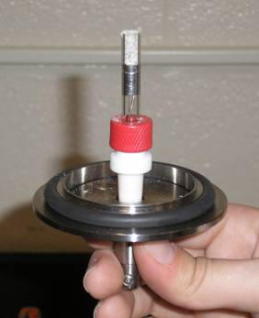
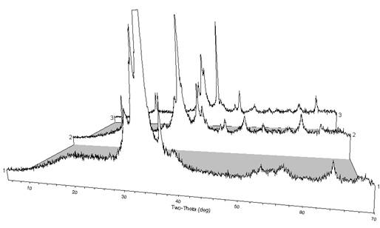
Glow-Discharge Plasma as a Synthetic Medium for Nanocrystalline Inorganic Non-Molecular Metal Oxides
Richard W. Schaeffer, Department of Chemistry and Biochemistry, Messiah College
The focus this year was in redesigning the cathode to increase the rate of product formation and deposition. Several different cathode designs were tried and products were characterized for stoichiometry using atomic absorption spectroscopy and phase composition using powder x-ray diffraction, which typically reveals crystalline CuO (tenorite) with some amorphous character, and various unidentified peaks.
In 2008-2009, different methods of introducing reactants into the plasma and different cathode configurations were explored. For example, a “cup” cathode configuration was used over a run time of 24-48 hours. The goal was to find a configuration that would allow reproducible formation of more than 100 mg of product in about 24 hours (or less). We continued to form copper oxide materials, but reliable characterization was problematic with the low yields realized to date. We are hopeful that continued work on the cathode design will lead to higher and more reproducible yields and more consistent and predictable product stoichiometry.

