Slide 1
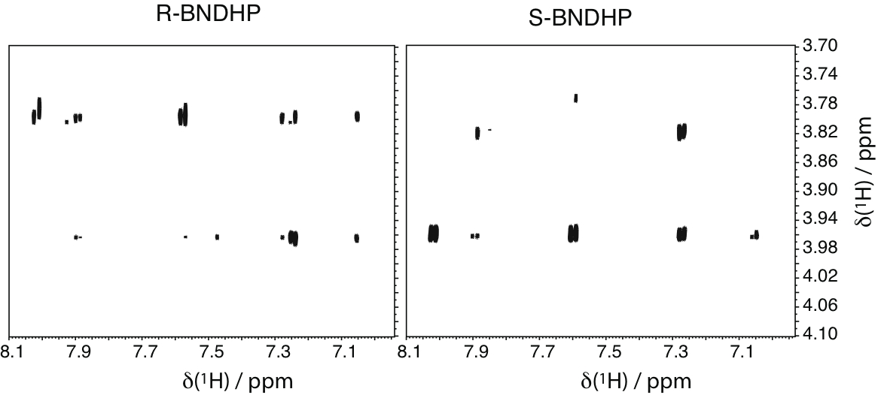
Chiral Solvation of BNDHP by Cholate Micelles
(i) symmetric contacts (NOE) with Me-18,19
(i) A hydrophobic pocket is formed by facial methyl groups of an antiparallel dimeric unit of cholate, and Me-21 lies in the hydrophobic plane
Me₂₁
Me₁₈
Me₁₉
H6
H5
H4
H7
H3
H8
(ii) Enantiomers of BNDHP are preferentially solubilized against opposite edge of an antiparallel dimeric unit
Me₁₉
Me₁₈
Me₂₁
Me₁₉
Me₁₈
{Chol}Me18
H4
H5
H3
H6,H8
H7
H3
{Chol}Me19
H7
H8
H4
H7
{Chol}Me21
Me₂₁
H5
H6
Cholate
R-BNDHP
(ii) inverted contacts (NOE) for edge groups
(ii)
H12
{Chol}H7
H4
H5
H3
H6,H8
H7
H7
{Chol}H12
S-BNDHP
H7
R-BNDHP
H12

