Slide 1
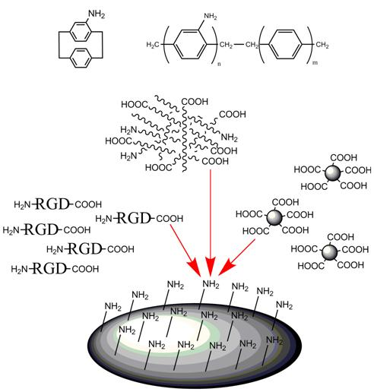
Active Orientation and Encapsulation of Bacteriorhodopsin-Driven Photo-Energy Transduction in Copolymer Shells
Dean Ho, Departments of Biomedical and Mechanical Engineering, Northwestern University, Evanston, IL 60208
Towards the realization of devices based upon biomolecular function, nanomaterial-based packaging strategies can be developed . Nanodiamonds and pary-xylene serve as examples of effective platforms towards biomolecular packaging . For example, nanodiamonds can be scalably processed and can bind to proteins while enabling the retention of their activity. Pary-xylene can be deposited via chemical vapor deposition at room temperature to support the maintenance of biomolecular function and can generate microfilm-based devices (Below: Left/Middle).
We aim to harness nanodiamond and pary-xylene properties to harness protein function (e.g. biological transduction, among others) towards applications in controlled release and energy. We have shown that proteins are effectively bound to nanodiamonds and that their function is preserved (Bottom, Right) Subsequent studies will seek to achieve switchable release for prolonged device activity from nanodiamond-protein complexes packaged within the microfilm devices.

