Slide 1
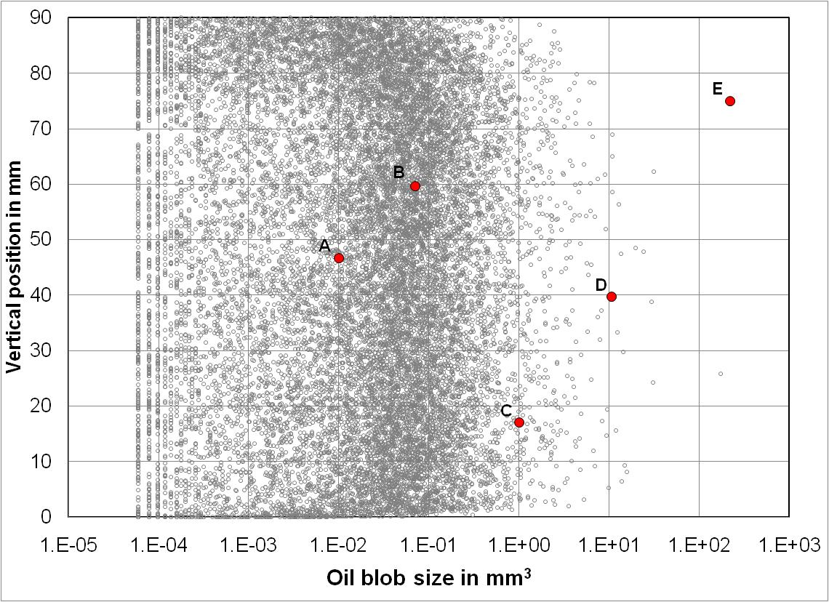
Characterization of trapped oil clusters in porous media using computed microtomography
Zuleima T. Karpyn, Department of Energy and Mineral Engineering
The Pennsylvania State University
E
B
Dry
Pre-sat
Drainage
Imbibition
A
D
Brine
Oil
Brine
C
+ Trapped oil clusters formed after drainage and imbibition are similar in size, shape and distribution.
+ 98% of the total trapped oil comes from blobs smaller than 1 mm³. Typical blob volumes range between 0.01-0.50 mm³.
+ Small blobs have large surface-to-volume ratio. As blobs grow, the ratio decreases to a critical value where volume growth is proportional to added surface area.

