Slide 1
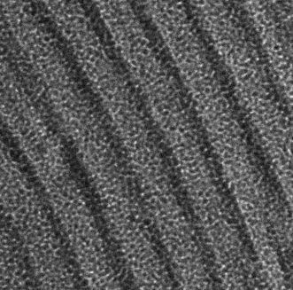
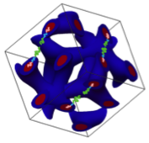
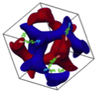
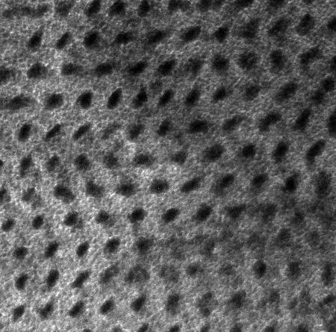
Templating Ion-Conducting Membranes Using Block Copolymers
We have investigated the self-assembly of cylinder-forming PS-b-PEO (SEO) block copolymers doped with various lithium salts. SAXS and TEM confirm that salt doping increases the domain spacing and segregation strength. Additionally, differences in the lithium counterion affect the copolymer morphologies and induce nanoscale phase transitions.
SEO:LiClO₄ 3:1
SAXS
TEM
Scale bar : 20 nm
RuO₄ staining
Ion-Conducting
Networks
SEO (non-doped)

