Slide 1
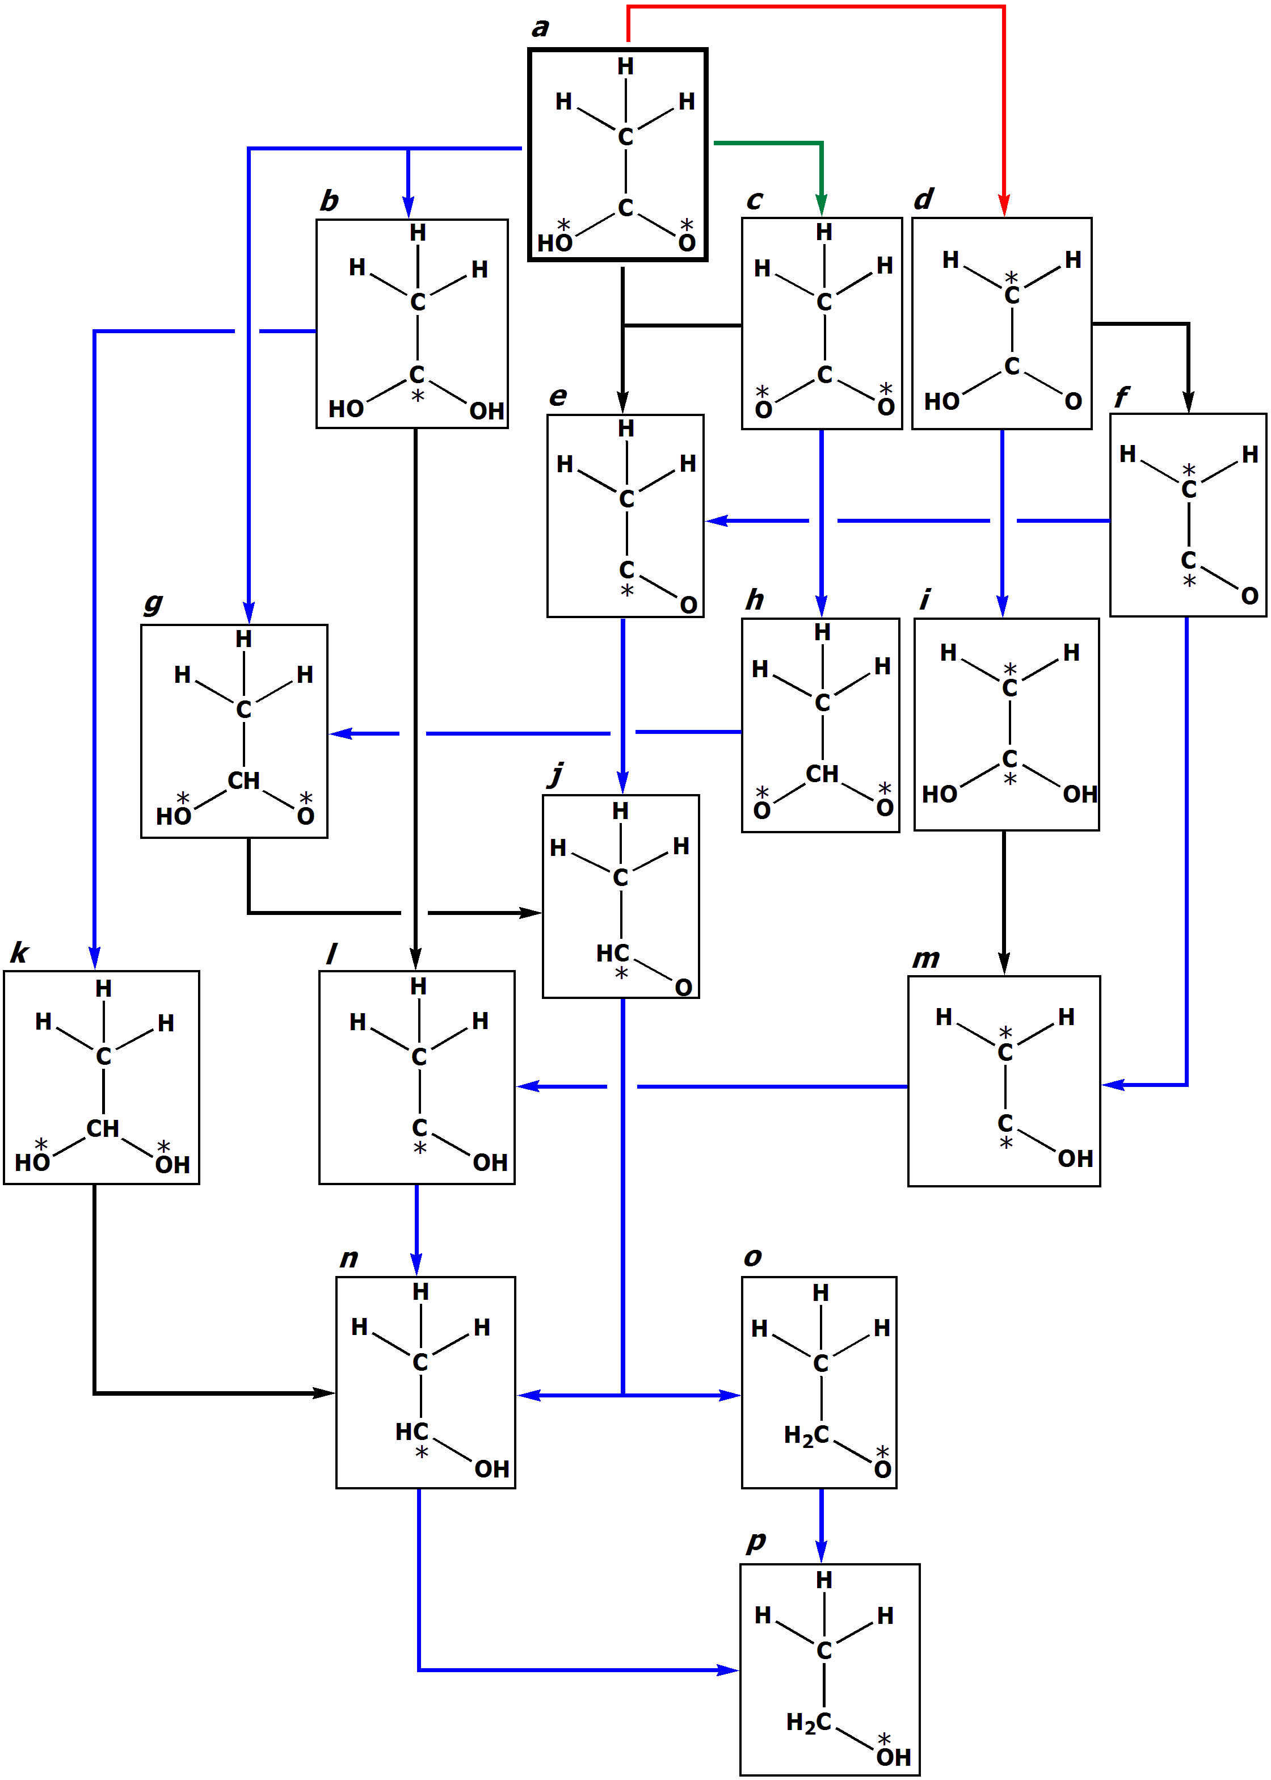
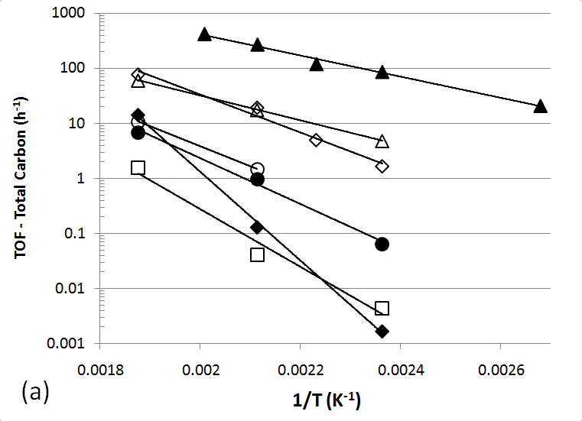
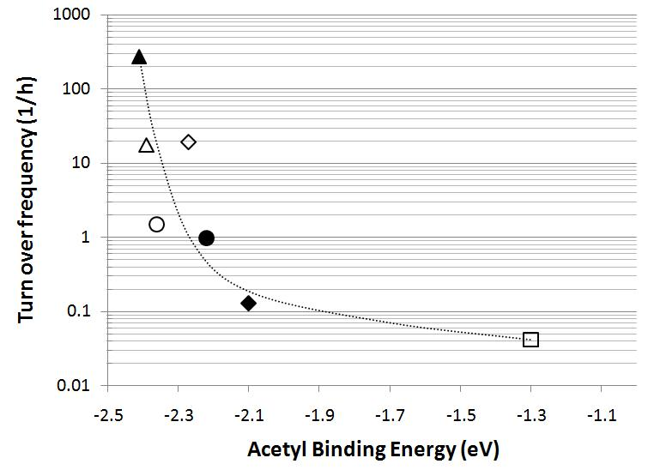
Design of Aqueous Phase Hydrogenation Catalysts for Biofuels Production
George W. Huber University of Massachusetts-Amherst
Reaction network
for acetic acid hydrogenation.
TOF for Acetic Acid Hydrogenation on different Metal
Supported Catalysts.
(Key: Cu, Ni, Rh, Pd, Pt, Ru, Ir)
Correlation between catalyst activity and binding energy of acetyl species.
Combination of experimental results with theoretical calculations gives us insight into how to design new generations of catalysts.

