Slide 1
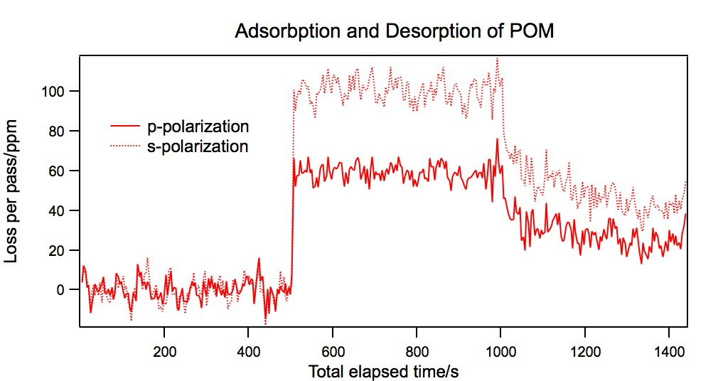
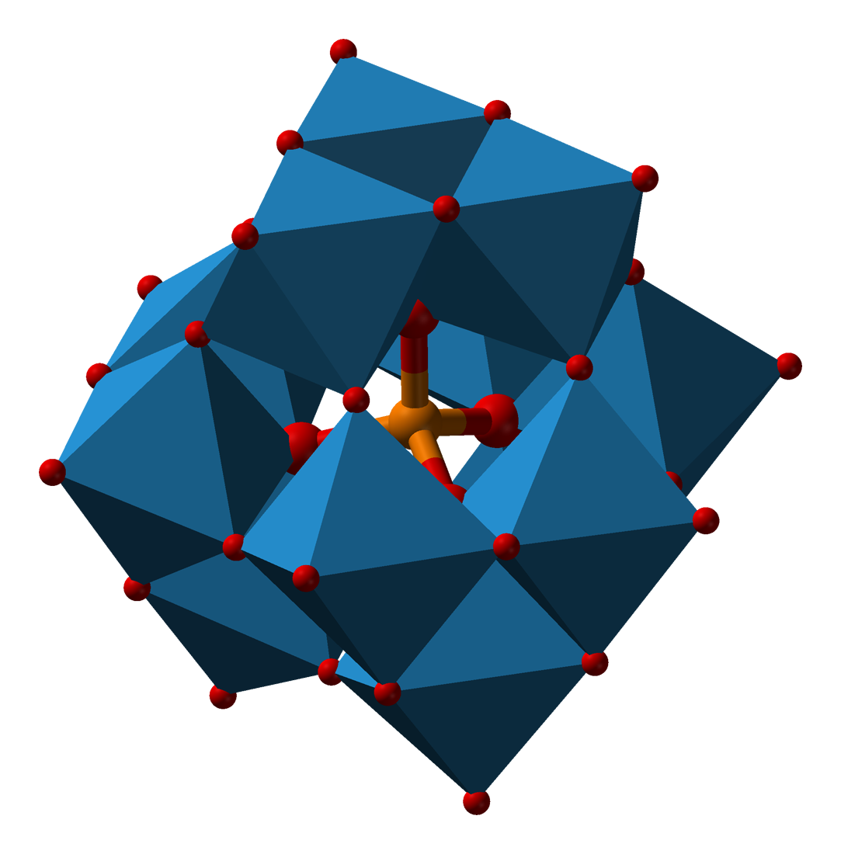
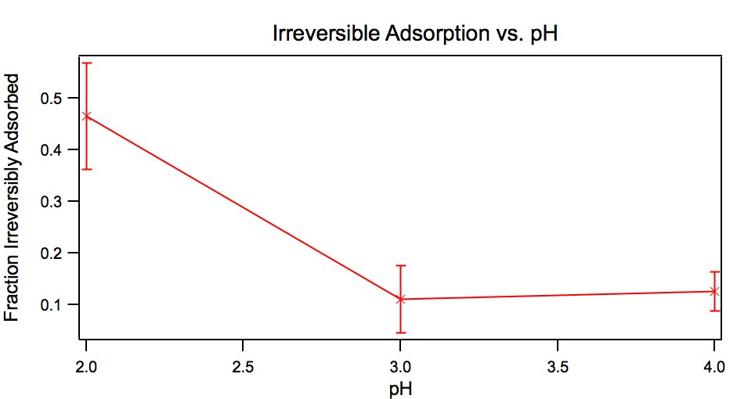
Interaction of polyoxometallates with organically-modified silica
Michael A. Everest
Desorption
6-
Adsorption
NH₃⁺
NH₃⁺
NH₃⁺
NH₃⁺
Evanescent-wave cavity ringdown studies show that the polyoxometallate K₆CoSiW₁₁O₃₉ readily adsorbs to silica which has been modified with (3-aminopropyl)trimethoxysilane, although it does not adsorb at all to clean silica. Moreover, the adsorption to the organically modified surface is found to be significantly less reversible (i.e. more stable) at pH 2 compared to pH 3 or 4. These studies may be relevant for the design of more efficient fuel cells.

