Slide 1
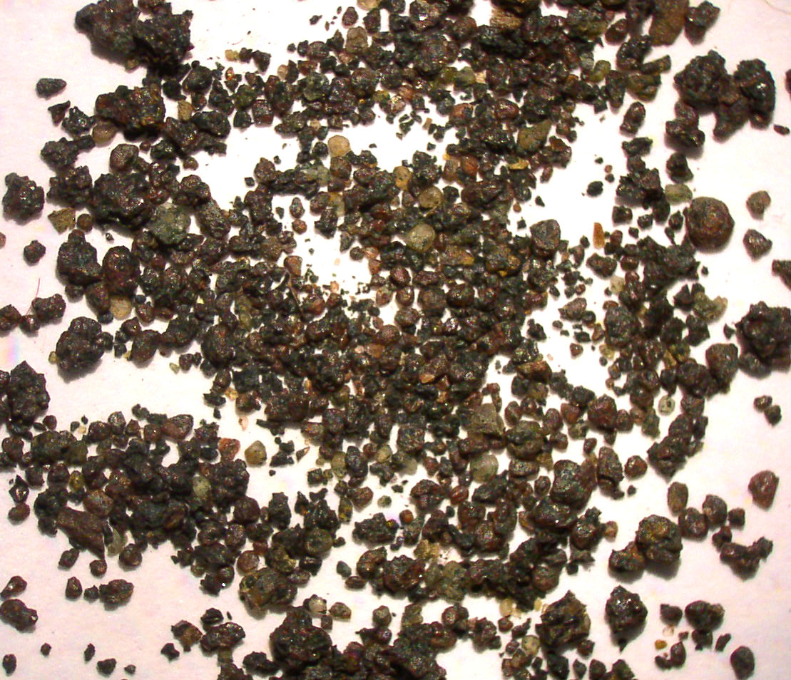
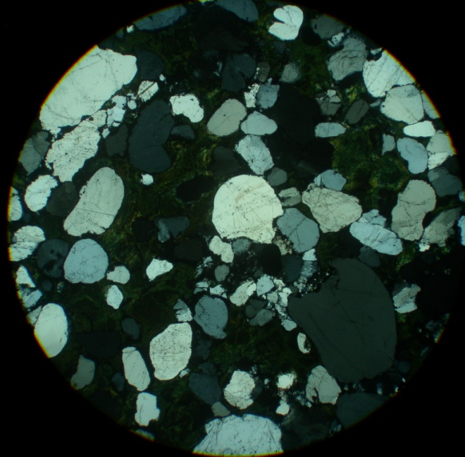
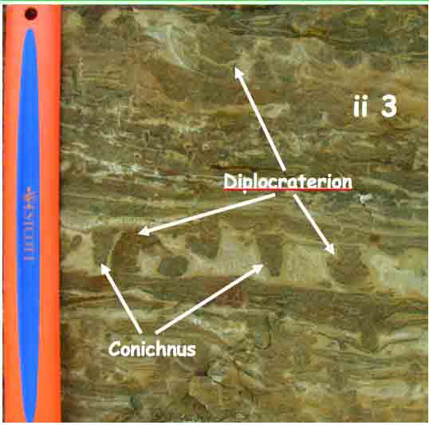
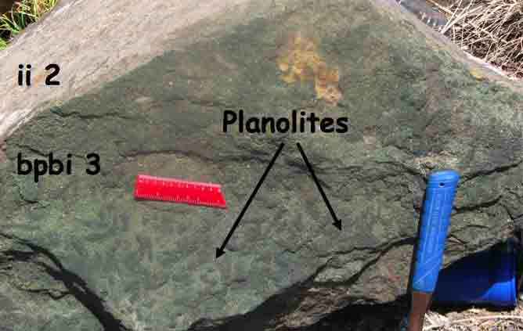
Glauconite Character and Ichnofabric Signature of Parasequences within Condensed Sections in Passive Margin Settings
Allan A. Ekdale, P.I.
Department of Geology and Geophysics, University of Utah
GLAUCONITE (sensu stricto) = A very green iron-magnesium-potassium-aluminum silicate mineral, which often takes on a pelletoidal form, and it forms almost exclusively as an authigenic constituent in marine sedimentary rocks (“greensands”).
Reno Sandstone Member, Lone Rock Formation, Cambrian, southwest Wisconsin
Lion Mountain Sandstone Member, Upper Riley Formation, Cambrian, central Texas
Analysis of glaucony in the Cambrian greensands in Texas and Wisconsin yields a result of >8% K₂O content, which would suggest a moderate glaucony maturity.
This result indicates a rather long residence time at the sea floor offshore, allowing the glaucony to form and mature in deeper, quieter water.
Subsequently, an appreciable degree of in situ reworking occurred as the water depth shallowed during regression before burial by subsequent sedimentation events.
Thus,the high-energy trace fossil suite does not represent the environment of glaucony formation.

