Slide 1

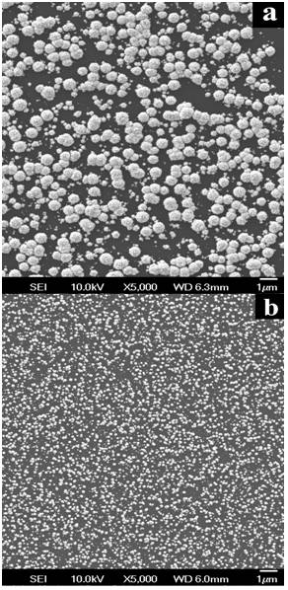
Catalyst Engineering Using Support-Dopant Modification:
Towards Intelligent Design of Catalyst Systems
Ryan O’Hayre, Department of Metallurgical and Materials Engineering, Colorado School of Mines
Motivation: Exploit a novel surface-modification technique to enhance the catalytic activity and durability of Pt/C systems relevant to fuel cell applications. Determine the fundamental mechanisms that underpin this effect.
Approach: Our experimental approach uses highly controlled, geometrically simple Pt/graphite test-systems. The fundamental mechanisms and effects of surface dopant modification are explored by comparing the structure, chemistry, and activity of doped versus undoped (control) catalyst systems (fig 1).
Results: Using SEM imaging combined with statistical image analysis methods, we have shown that N-modified graphite surfaces lead to significantly smaller average Pt particle size (by approximately a factor of two) and a narrower Pt particle size distribution while also leading to reduced particle agglomeration, all of which are desirable catalyst properties (fig 2). Using electrochemical techniques (IV, CV, EIS), we have shown that these N-modified catalyst systems exhibit catalytic activities that are as much as 2-3X higher (mass-normalized) than the typical commercial Pt/C catalysts used today (fig 3).
Figure 1. Our experimental approach
Mass Activity (A/g)
1.6
1.2
0.8
0.4
0
Figure 2. Comparison of unmodifed (a) vs. N-modified (b) catalyst
Our Pt/C catalyst
Typical Pt/C catalysts
Figure 3. Our catalyst has high performance

